Slide 1
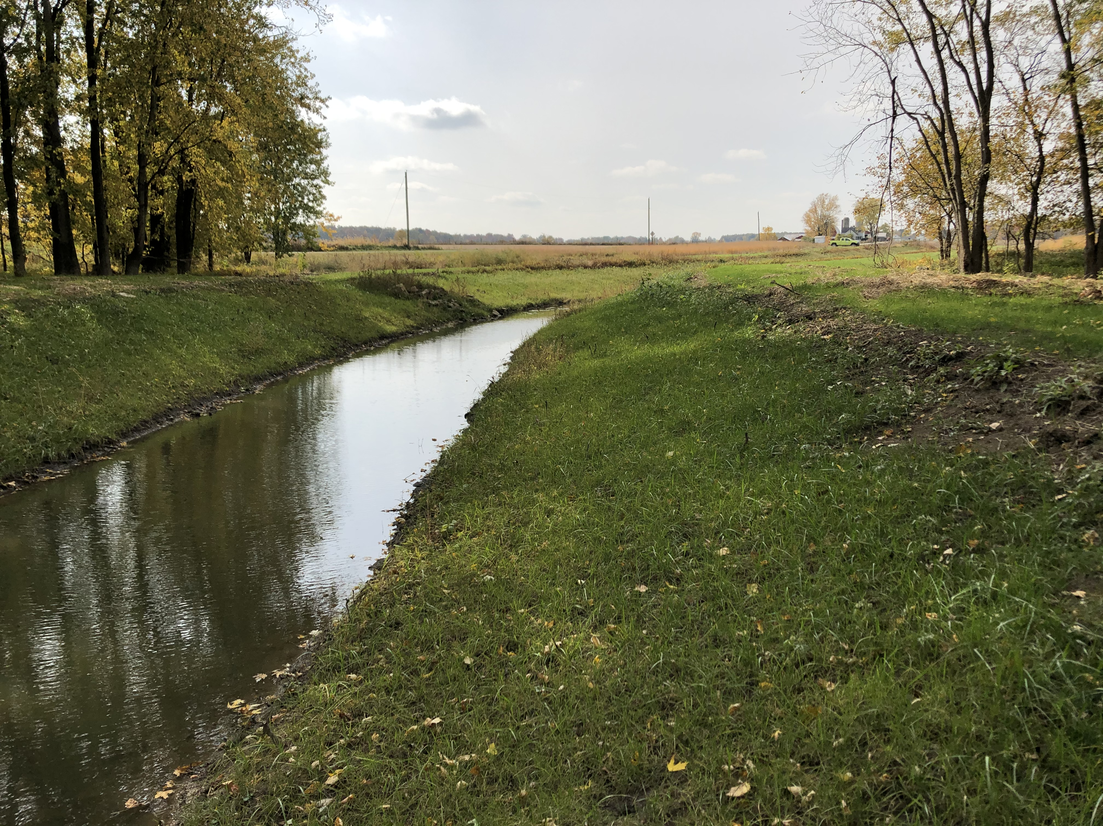
Proposed Revisions to Ohio’s Drainage Laws
Ohio Drainage Law Revision Task Force
Presented by:
Doug Reinhart, P.E., P.S.
Auglaize County Engineer

Slide 2
History of Ohio Drainage Laws
1ST Public Ditch Laws 1850’s-1860’s (Mirrored Road Petition Law)
August 23, 1957 - Permanent Maintenance Amendment Became Effective
Late 1960’s - Senate Bill 160; ORC Section 1515; Petitions Through SWCD
1981 - Multiple Changes Eliminating some of the Antiquated Language
1986 - Amendment to Reduce Easement on Open Ditches to 25’ and Mandate 4’ Permanent Sod Strip (up to 15’ reduced from taxes)
2013 - Amendment to 940 mandating certified mail to owner adjacent to property
2020 HB 340 Sponsored by Representative Cupp

Slide 3
Auglaize County Petition Ditches
71.05 miles of log jam removal
170.47 miles of open ditches
124.01 miles of tile ditches
8.17 miles of grass waterways
373.7 miles of ditch maintenance

Slide 4
Ohio Drainage Revision Task Force
Task Force was first established October 11, 2013
Chairman:
Steve Stolte, Union County Commissioner
Members:
County Engineer’s Association
Soil and Water Conservation Board and Staff
Ohio Farm Bureau Federation
Ohio State University Extension
County Auditors
Ohio Department of Agriculture

Slide 5
OHIO REVISED CODE SECTIONS
ORC 940: Soil and Water Petitions
(formerly ORC 1515)
ORC 6131: Single County Ditch Petitions
ORC 6133: Joint County Ditch Petitions
ORC 6137: Permanent Maintenance of Ditches
HB 340: 156 PAGES AND 4,585 LINES

Slide 6
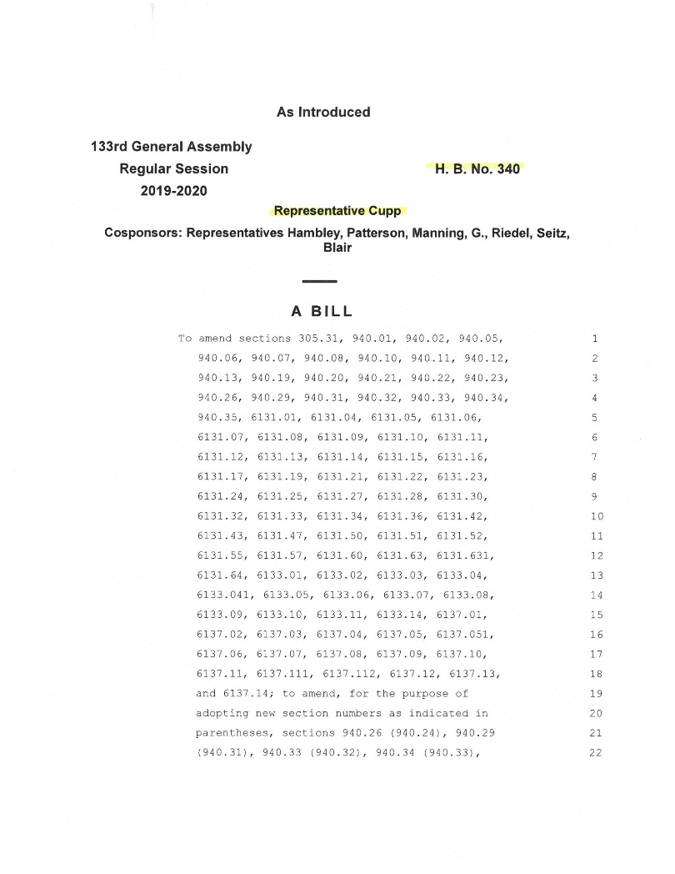

Slide 7
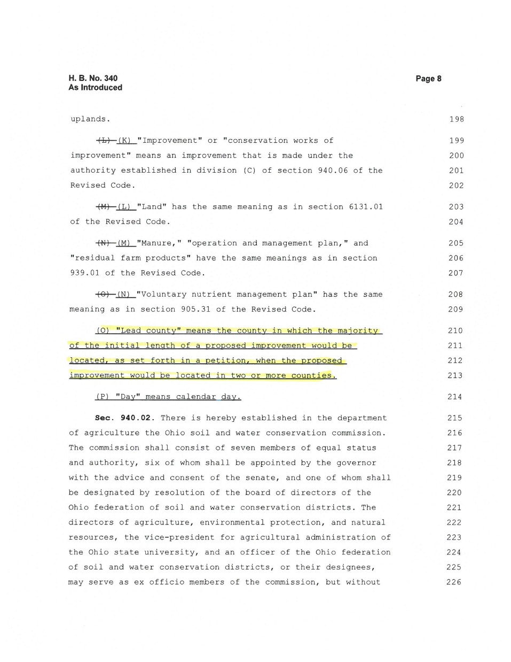
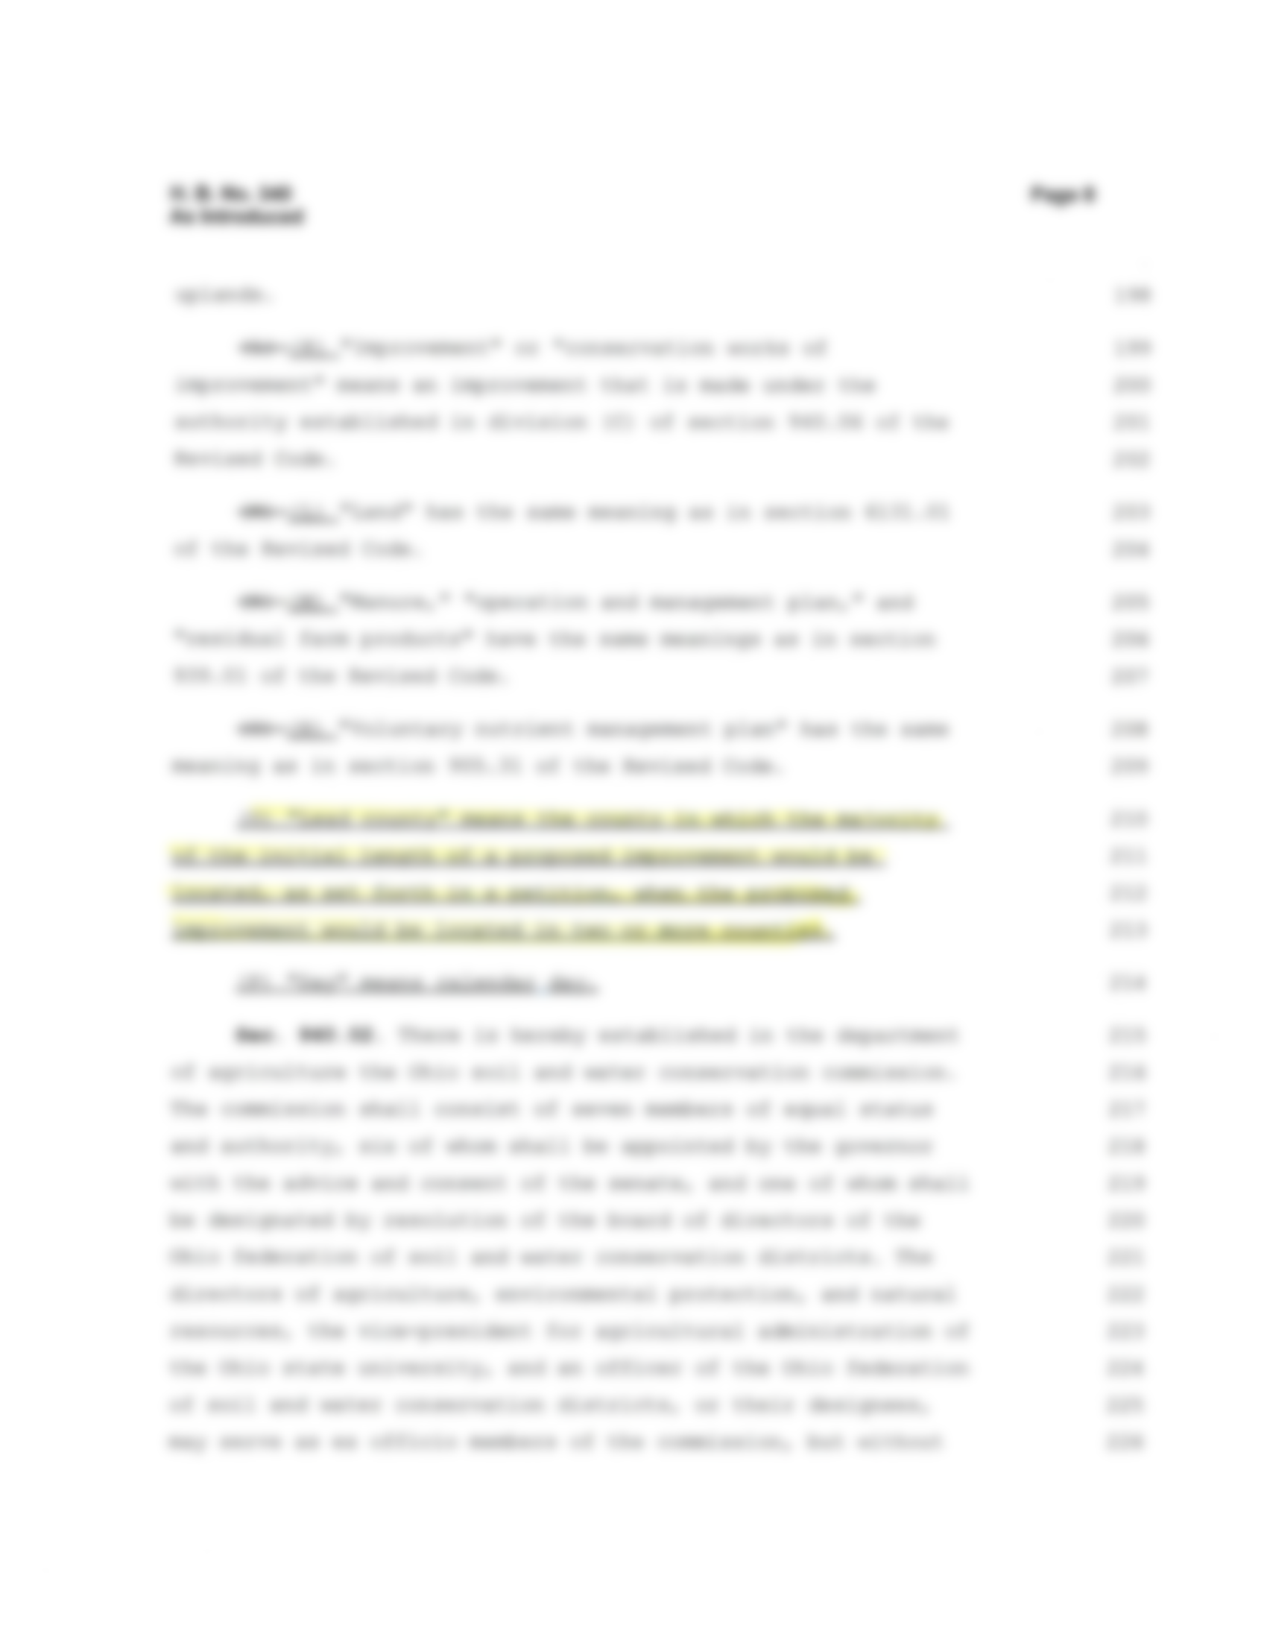


Slide 8
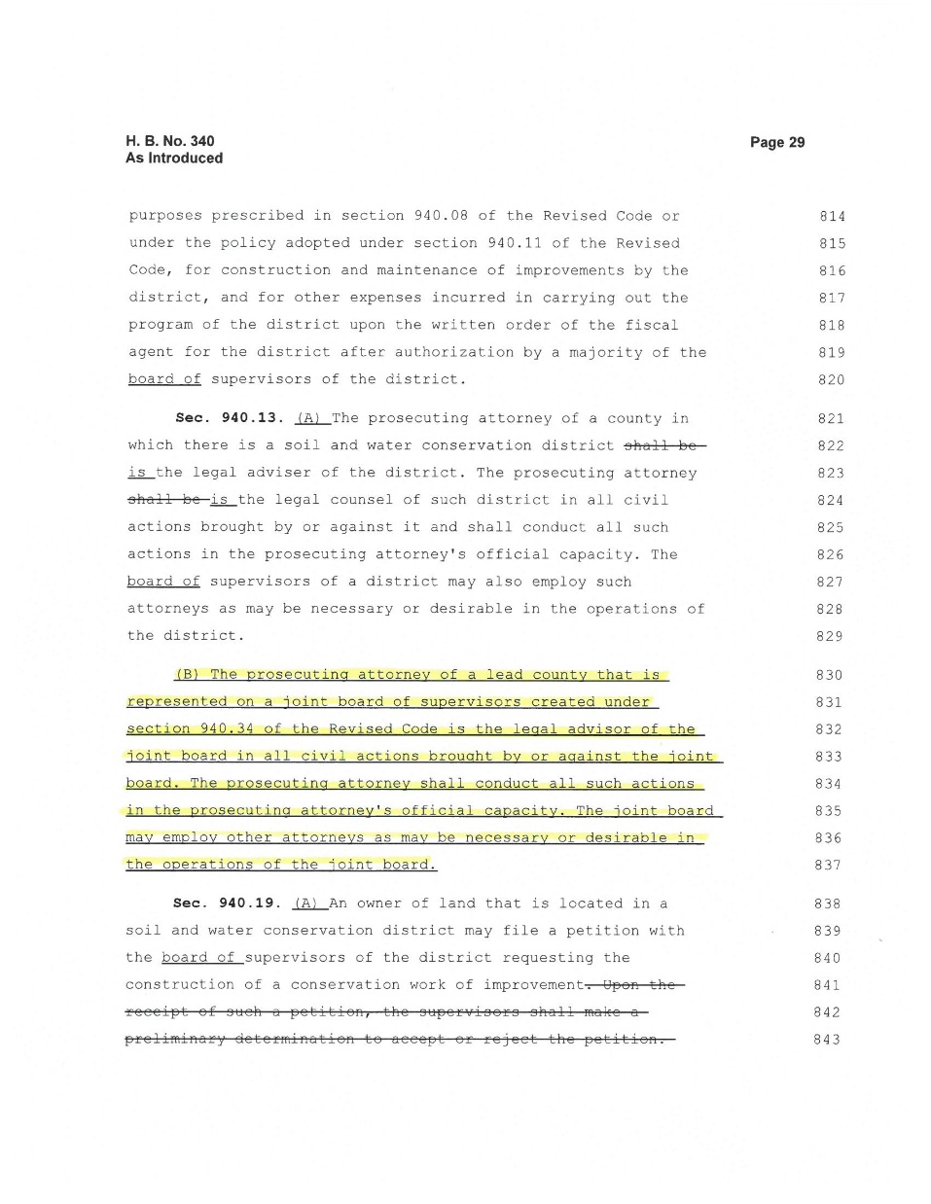
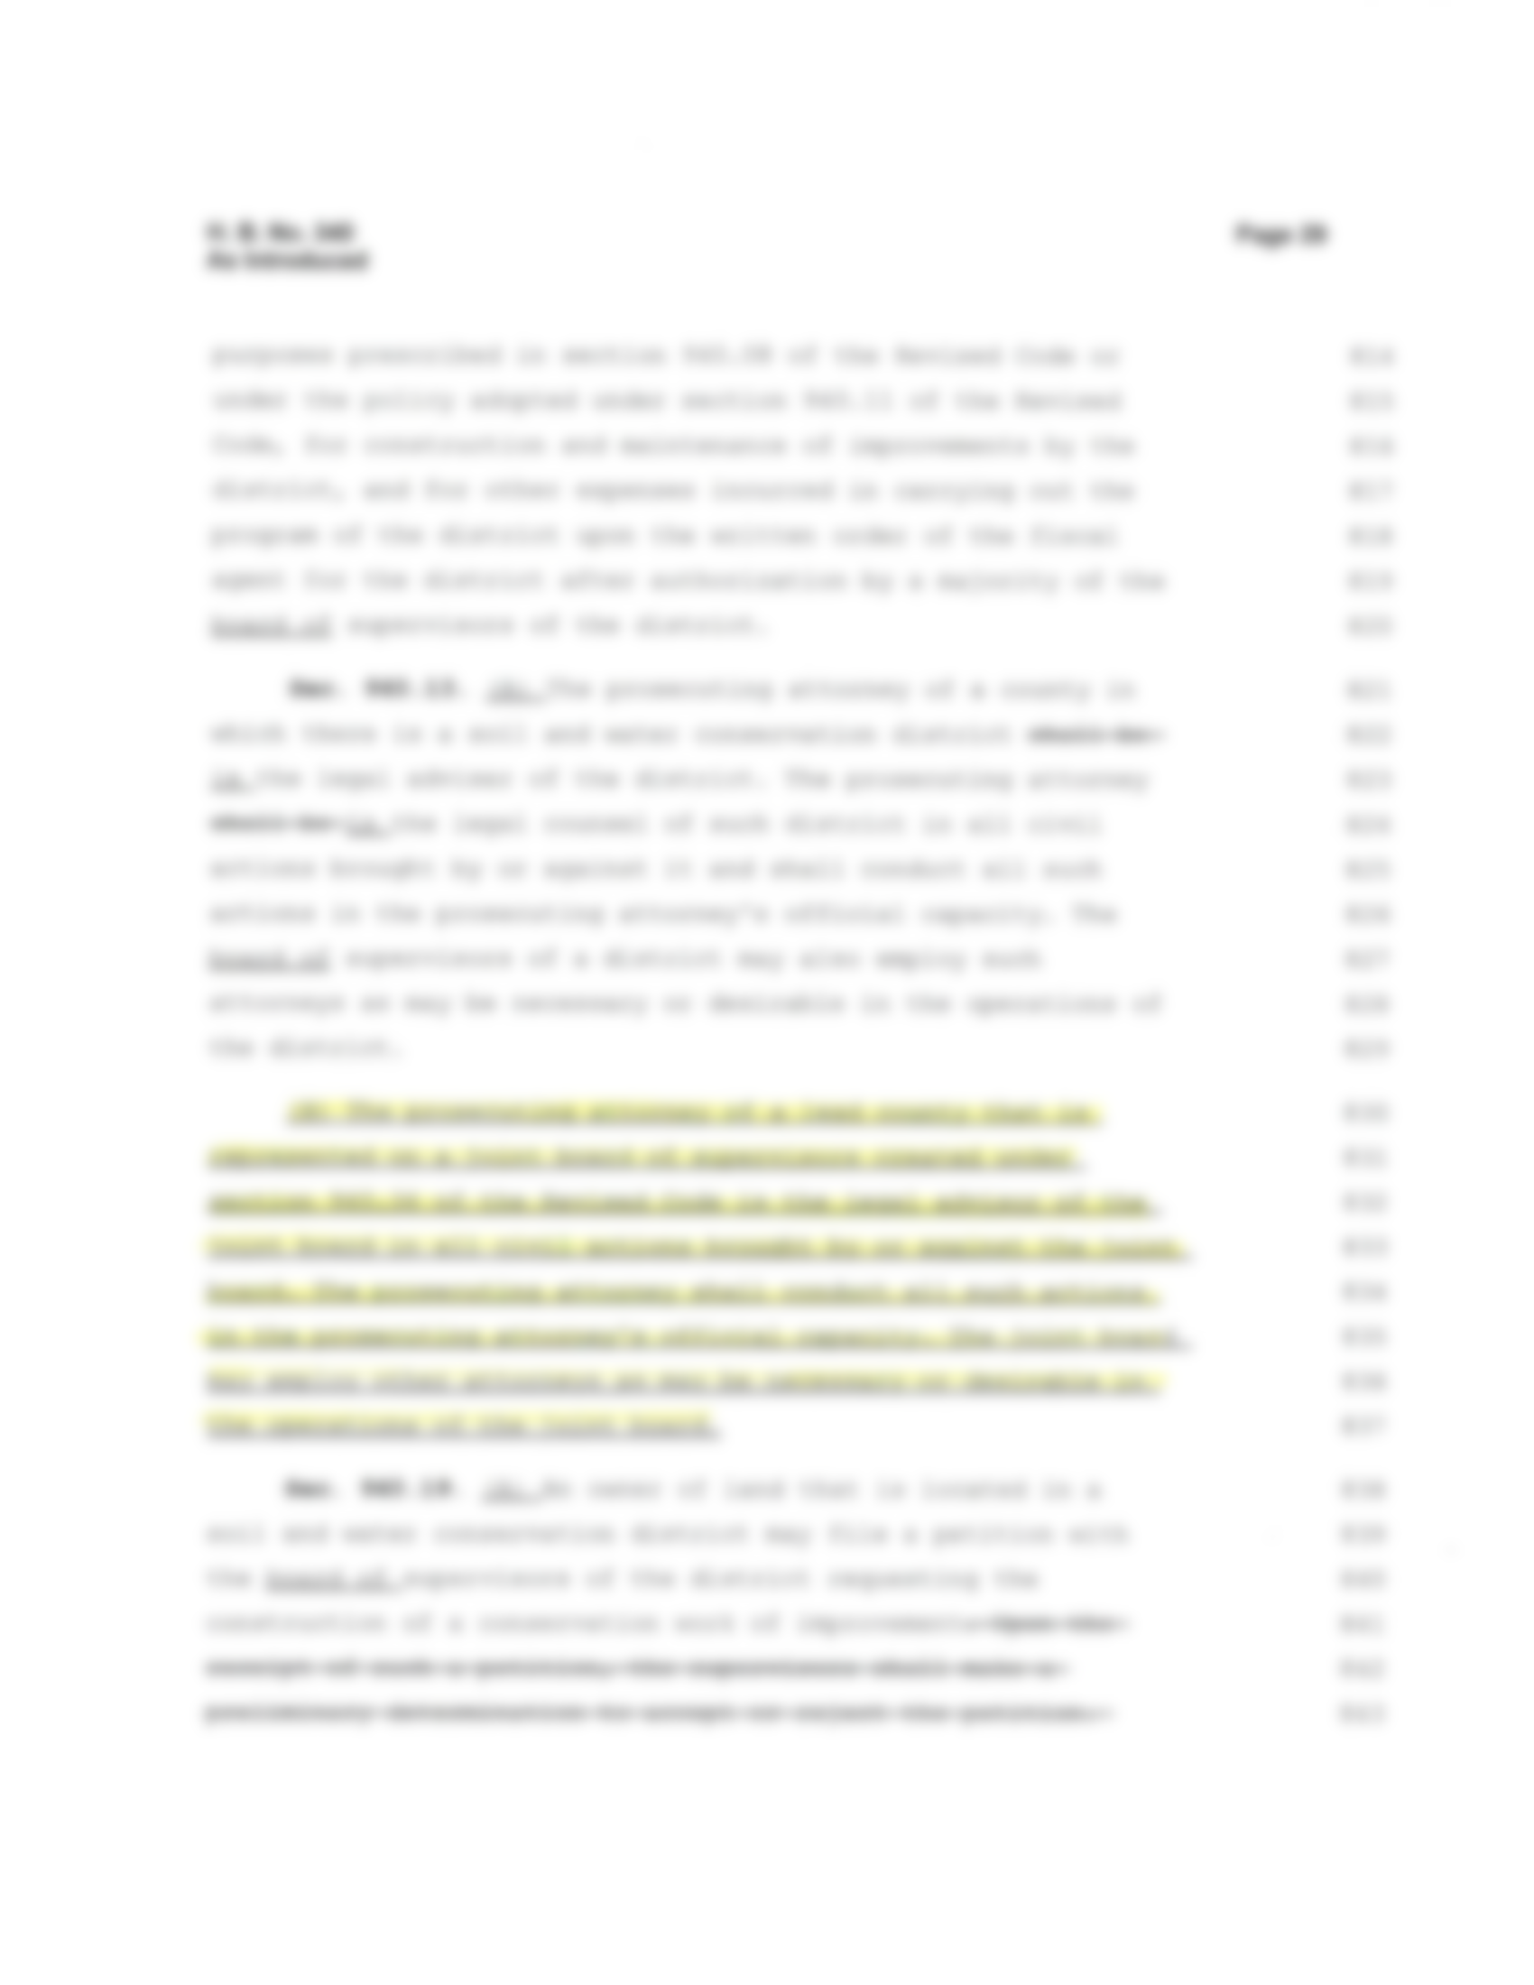
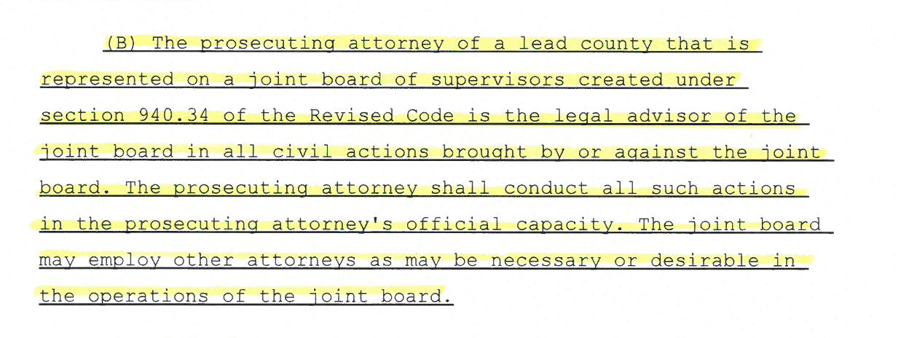

Slide 9
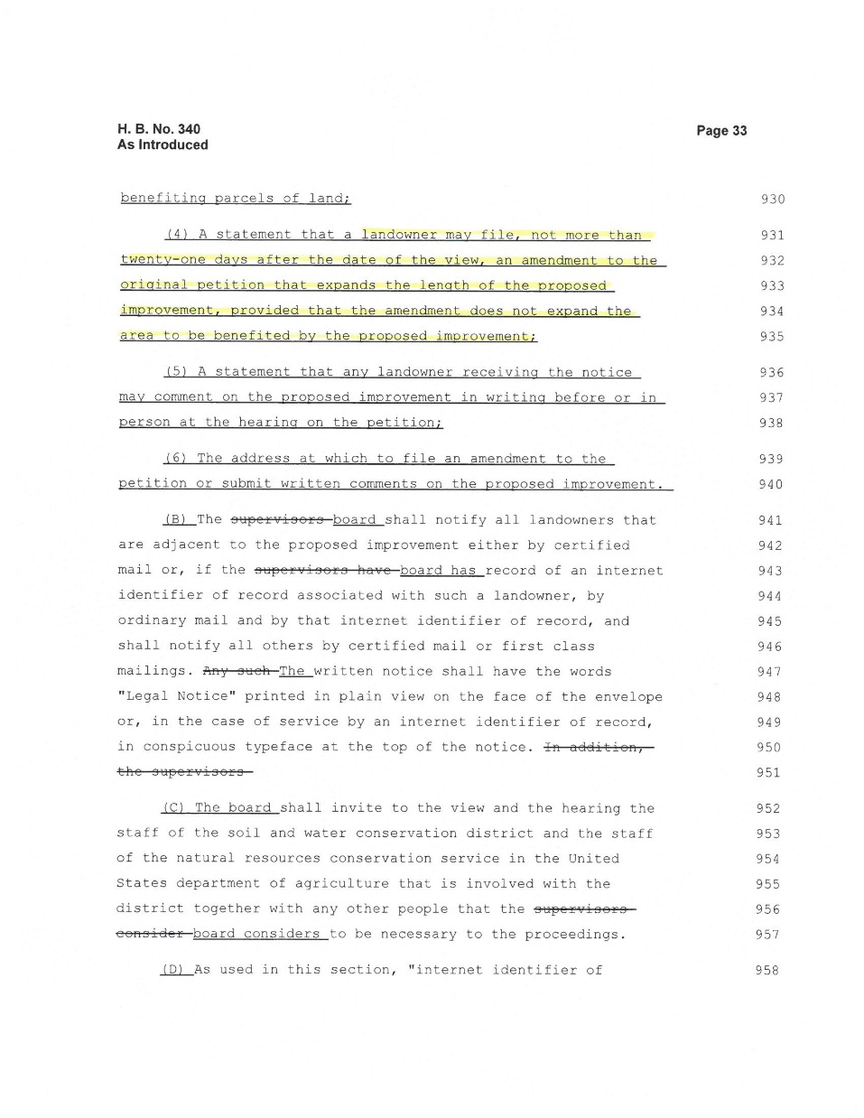
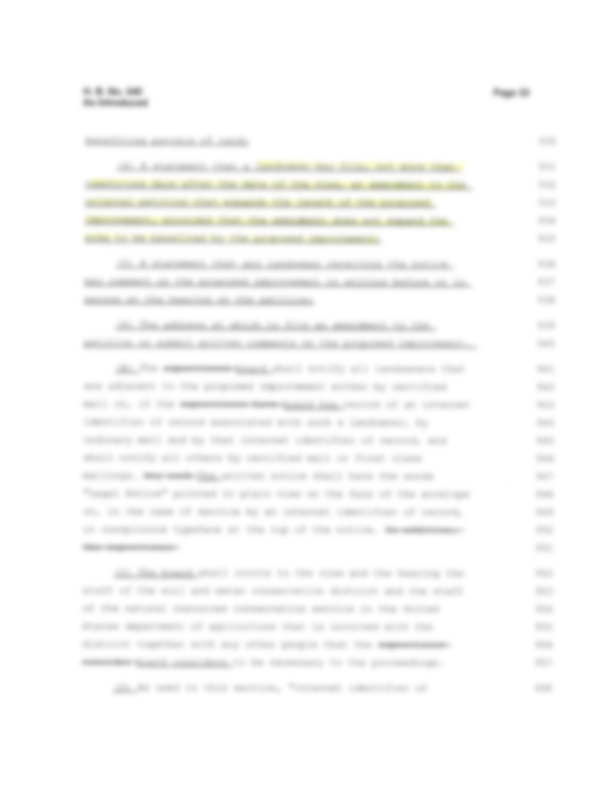


Slide 10
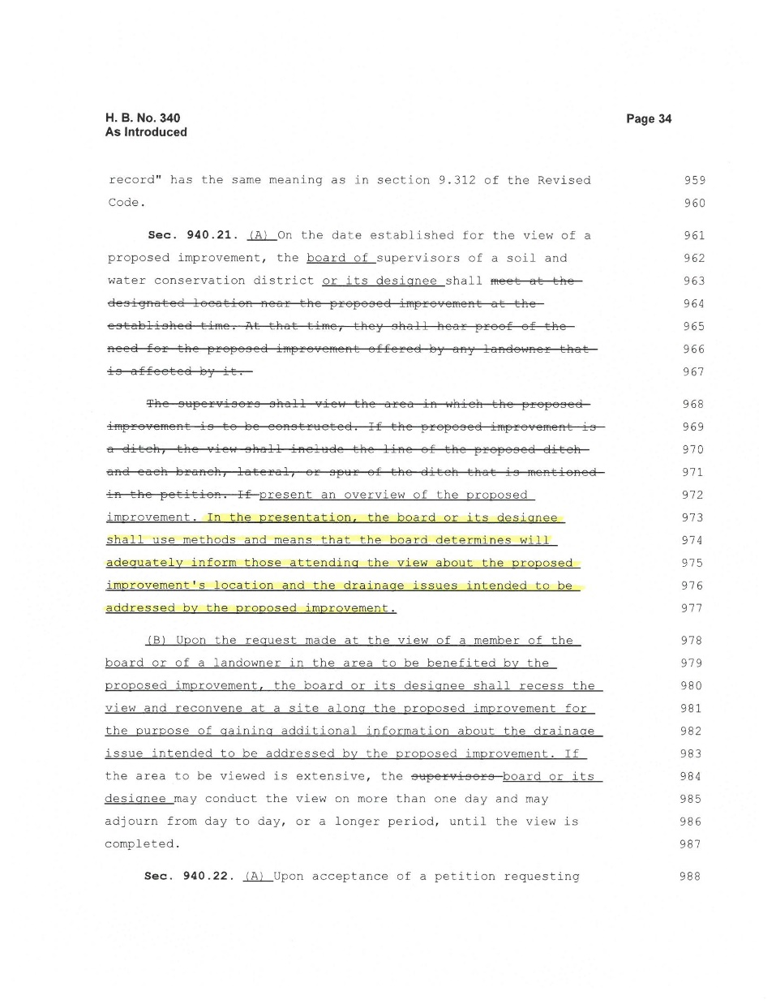
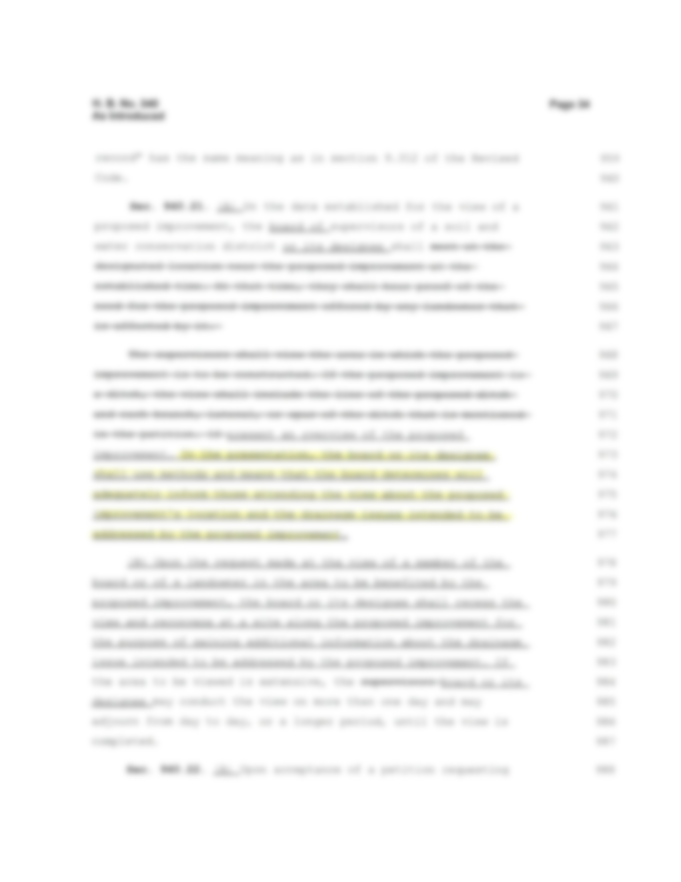


Slide 11
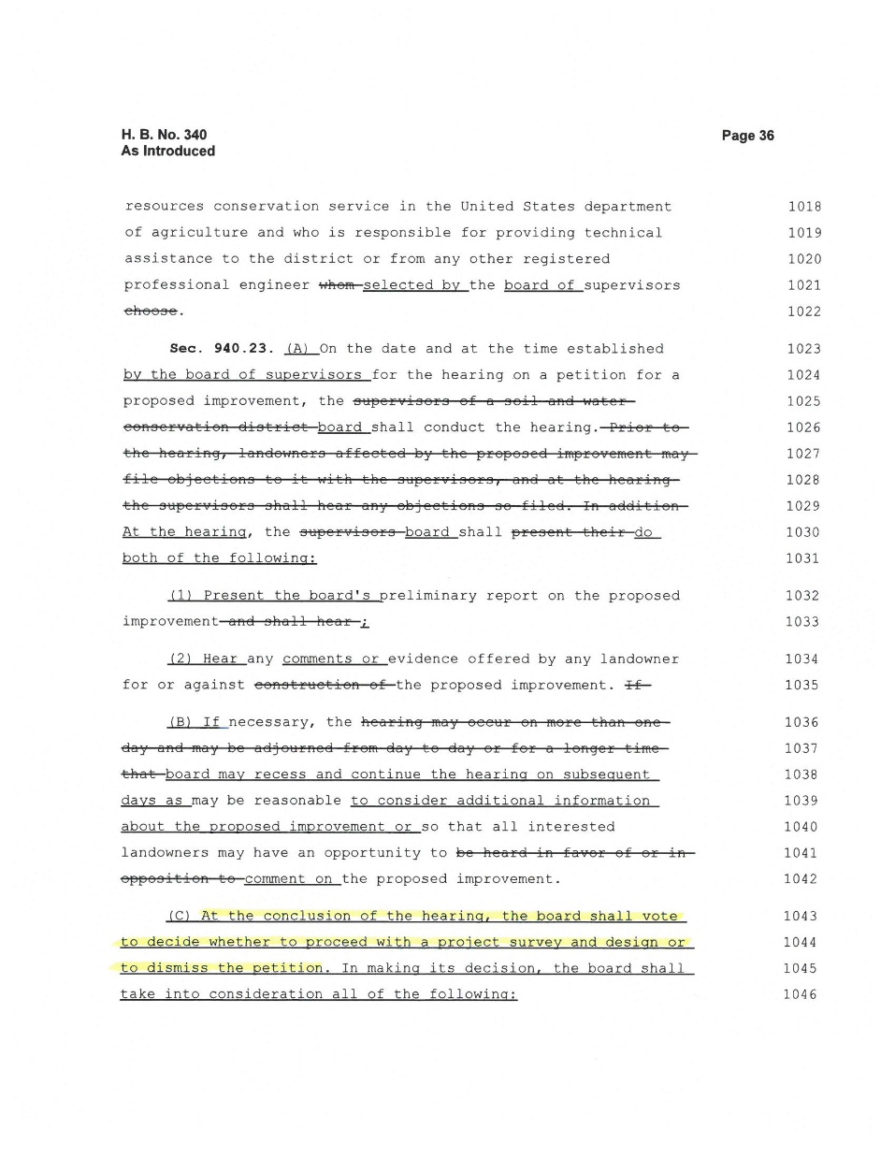
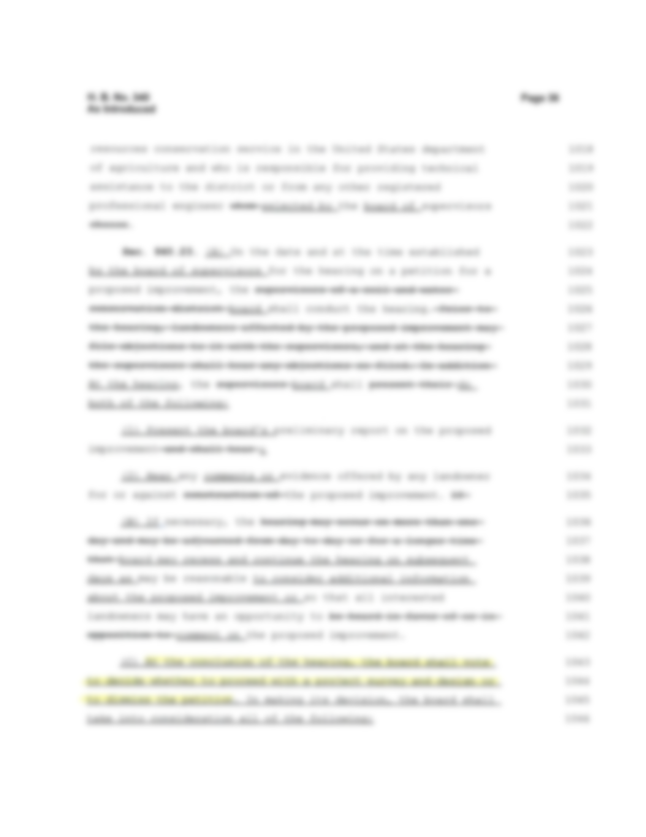
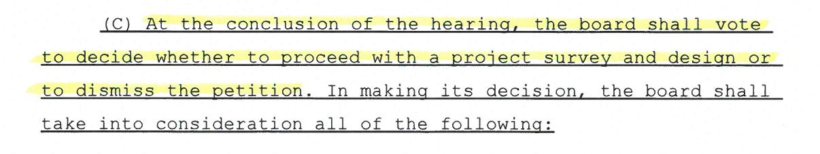

Slide 12
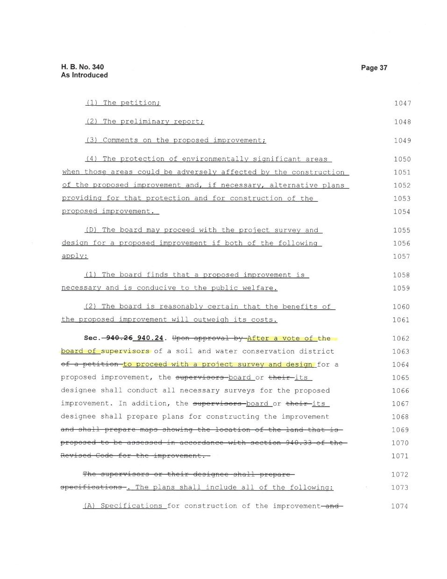
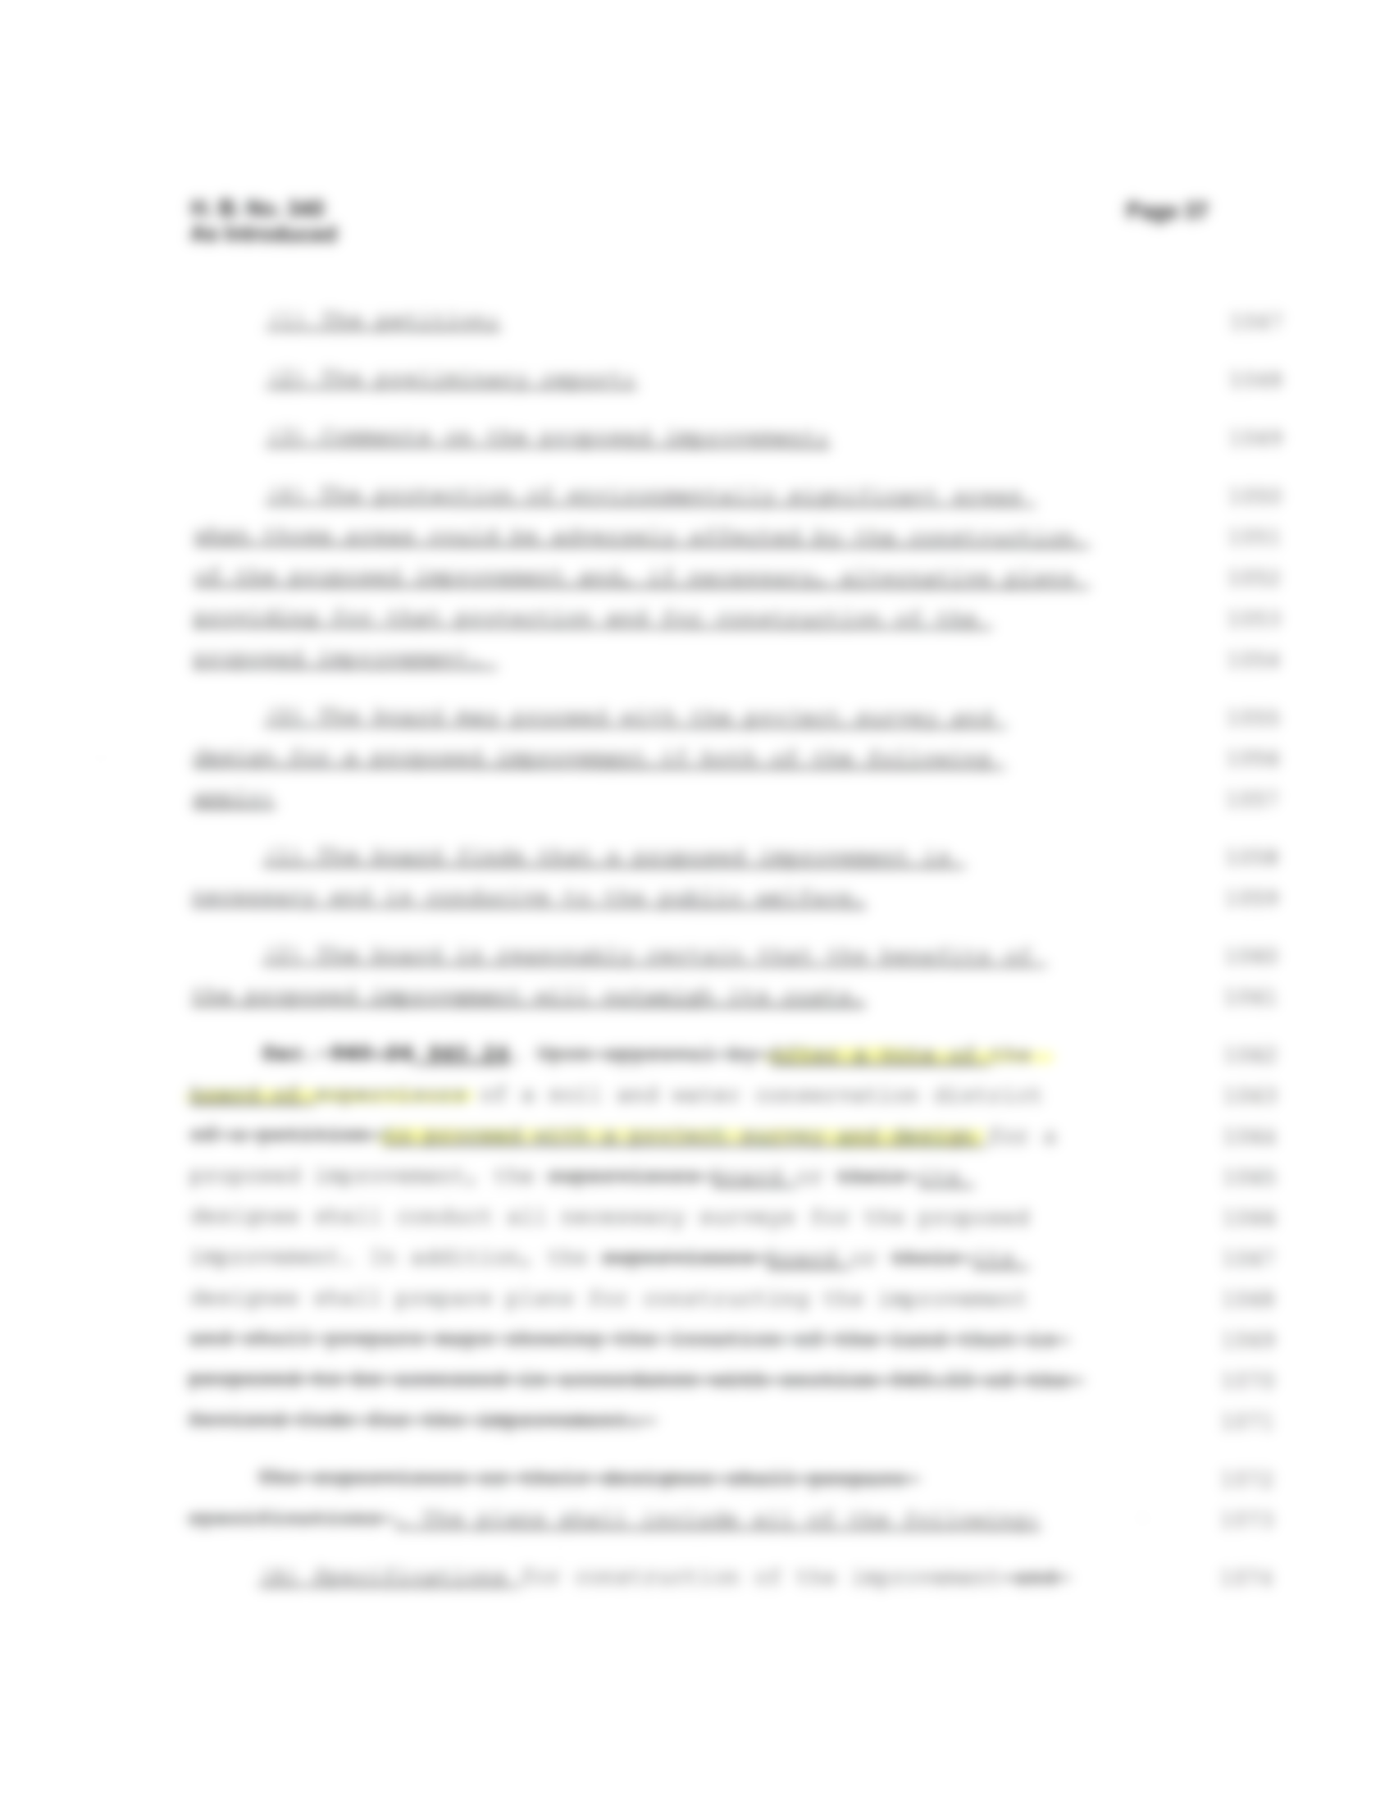


Slide 13
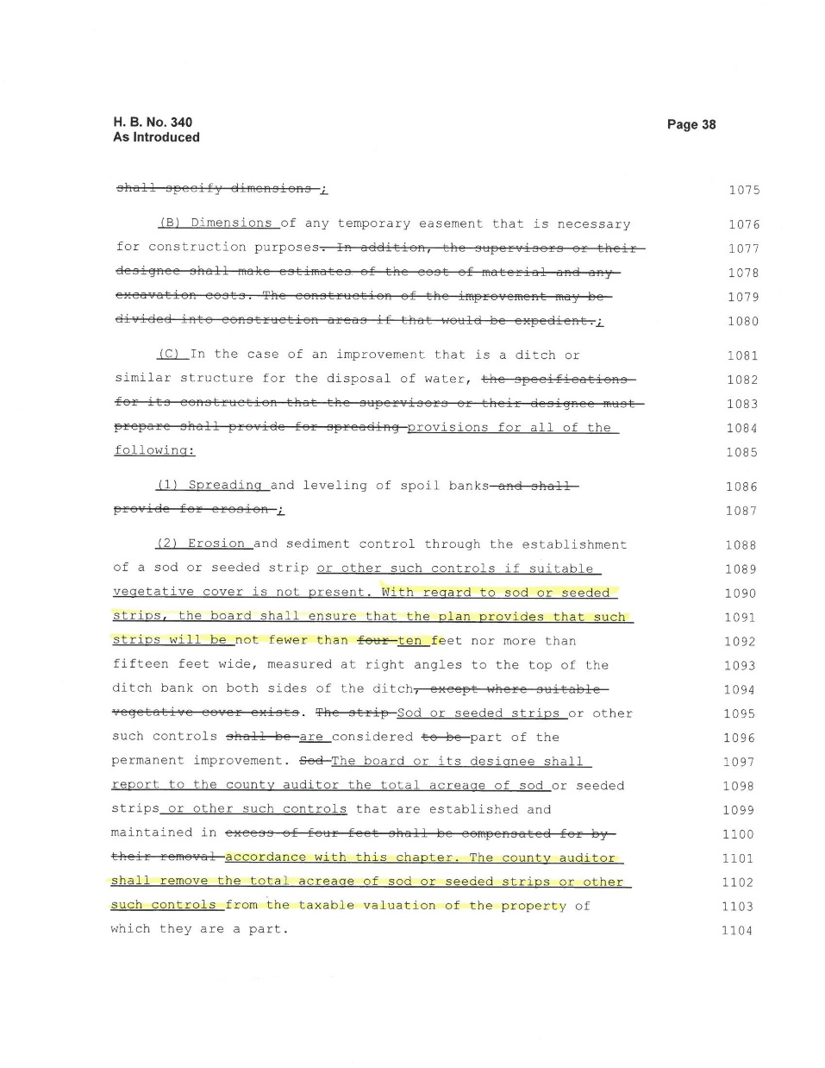
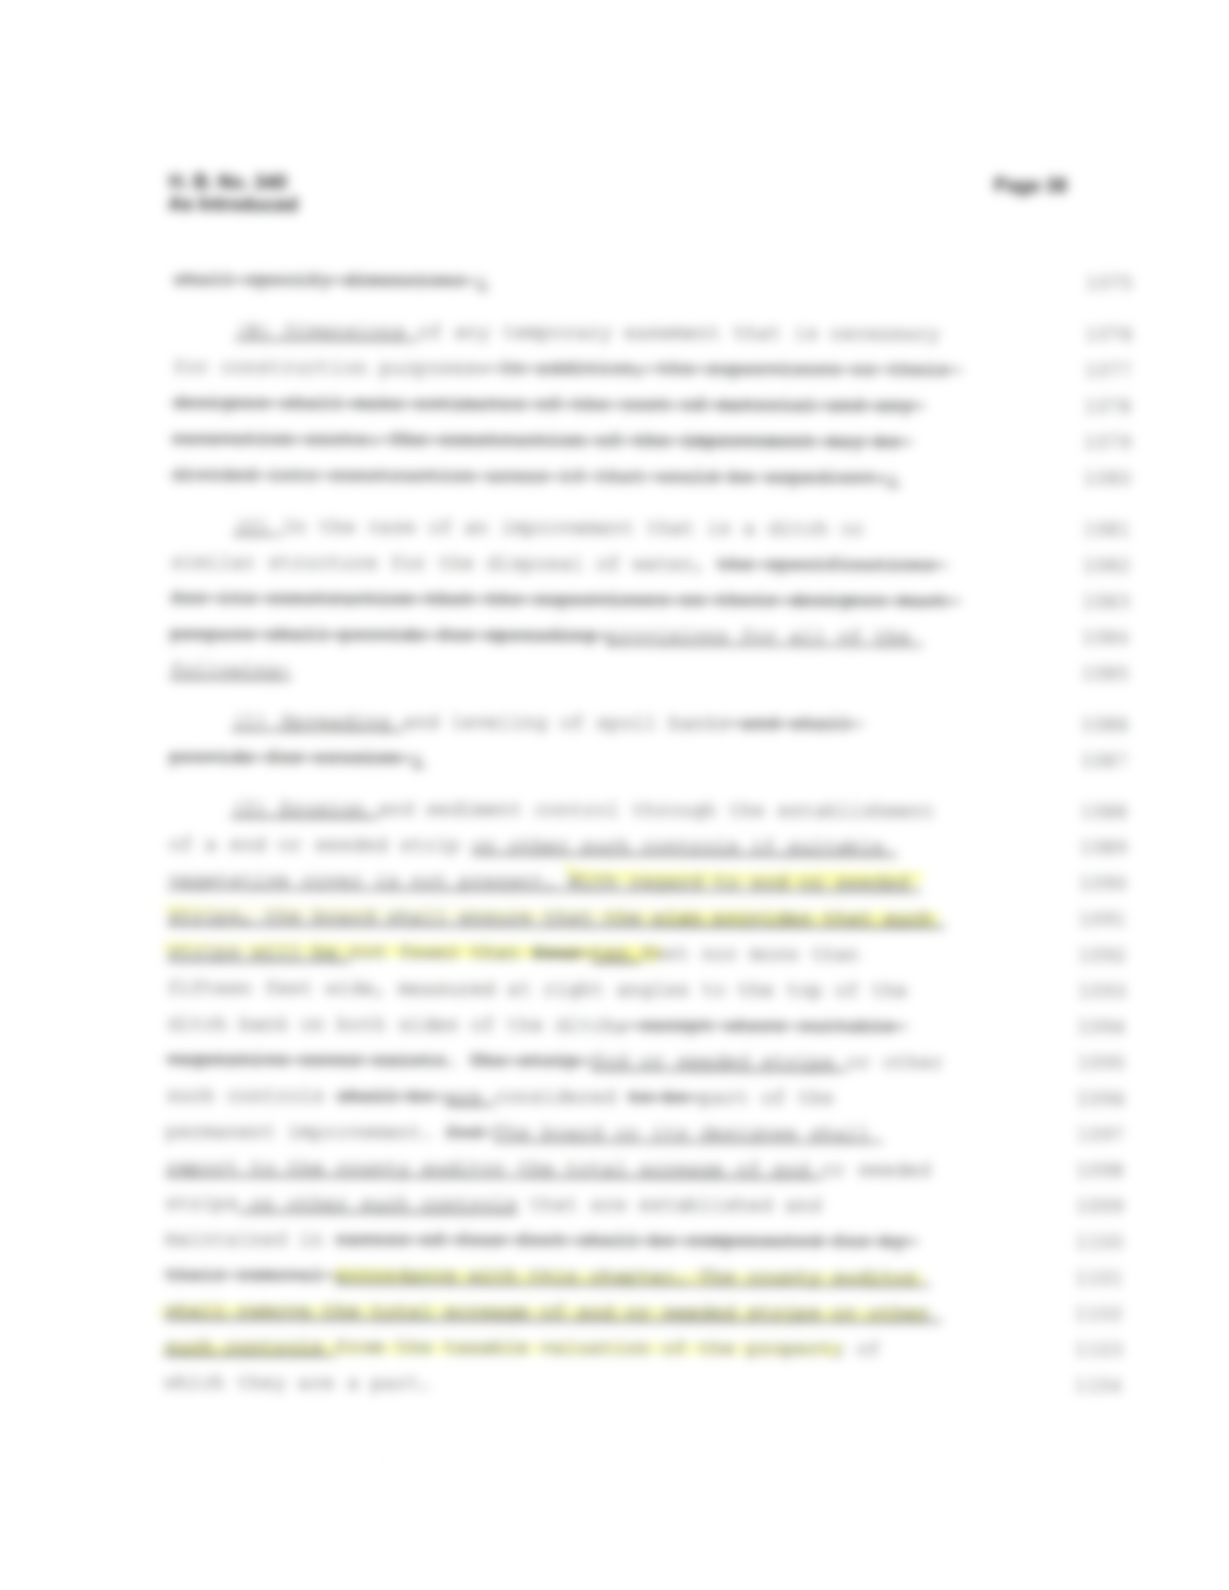
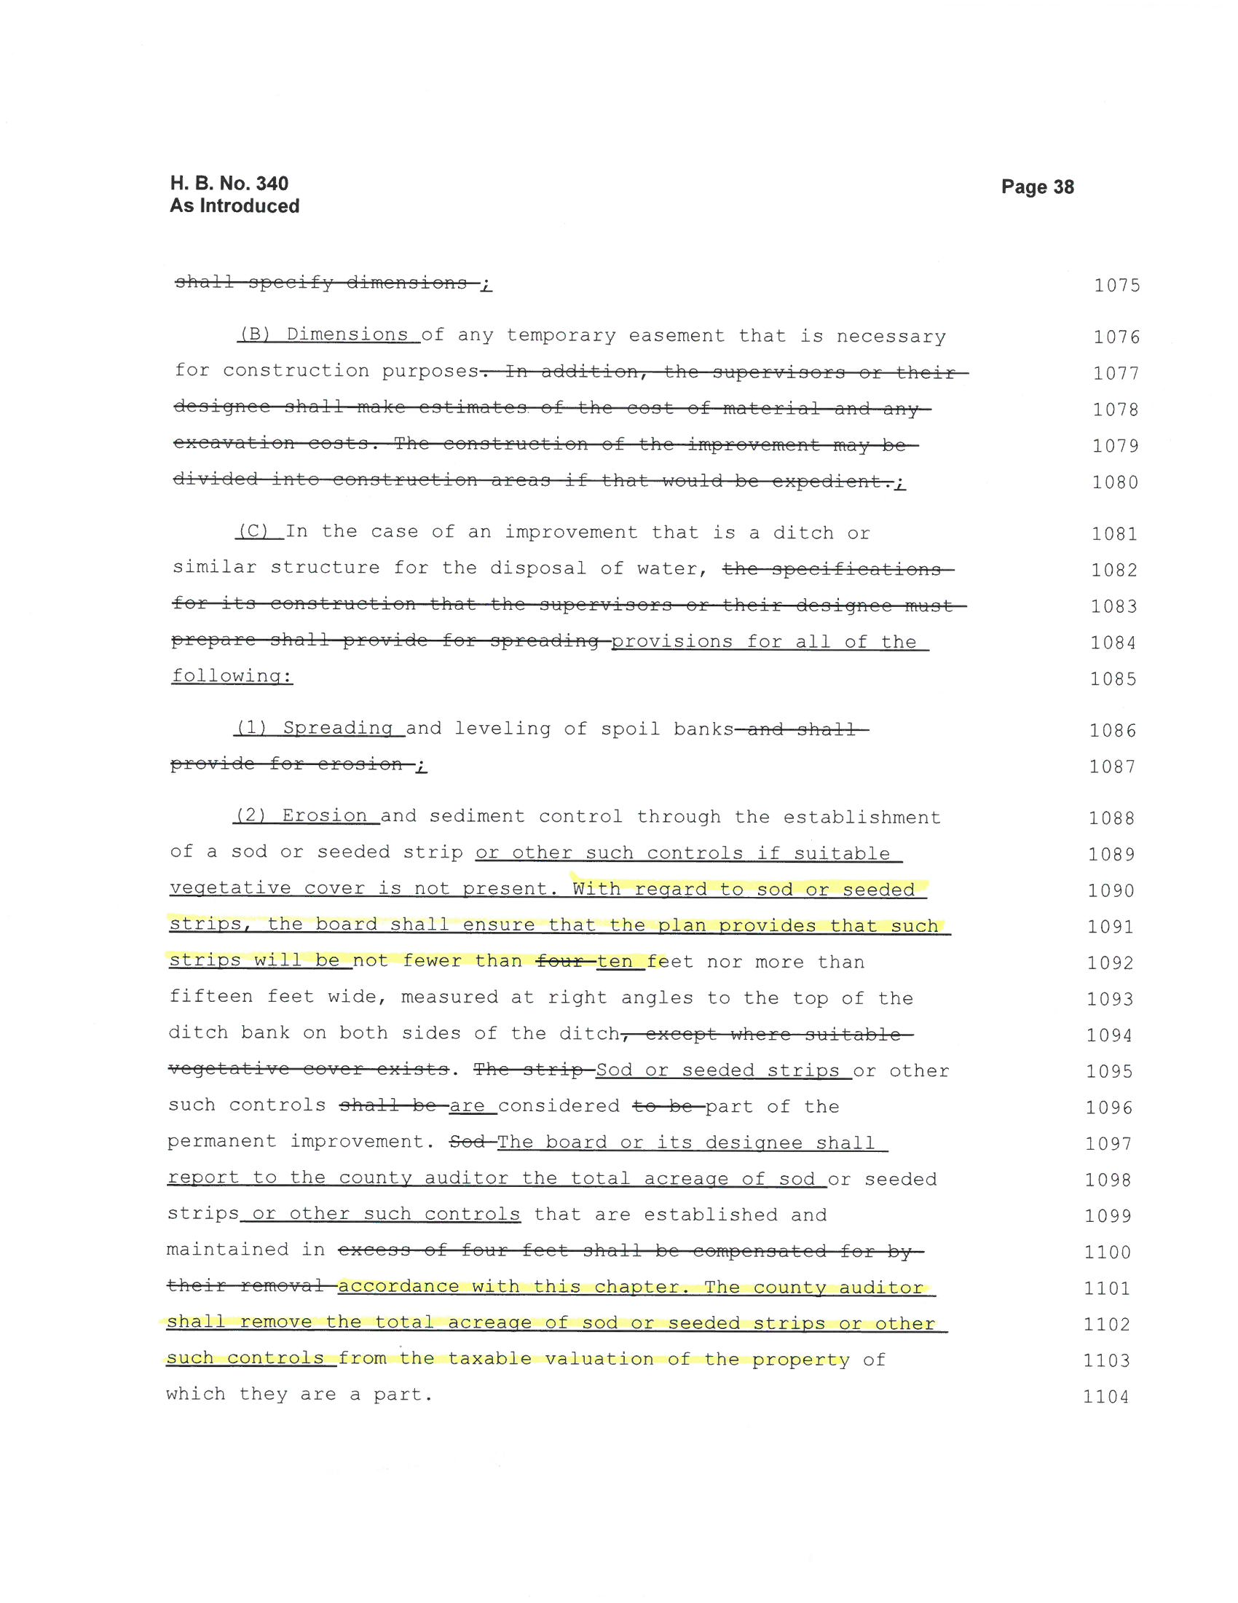

Slide 14
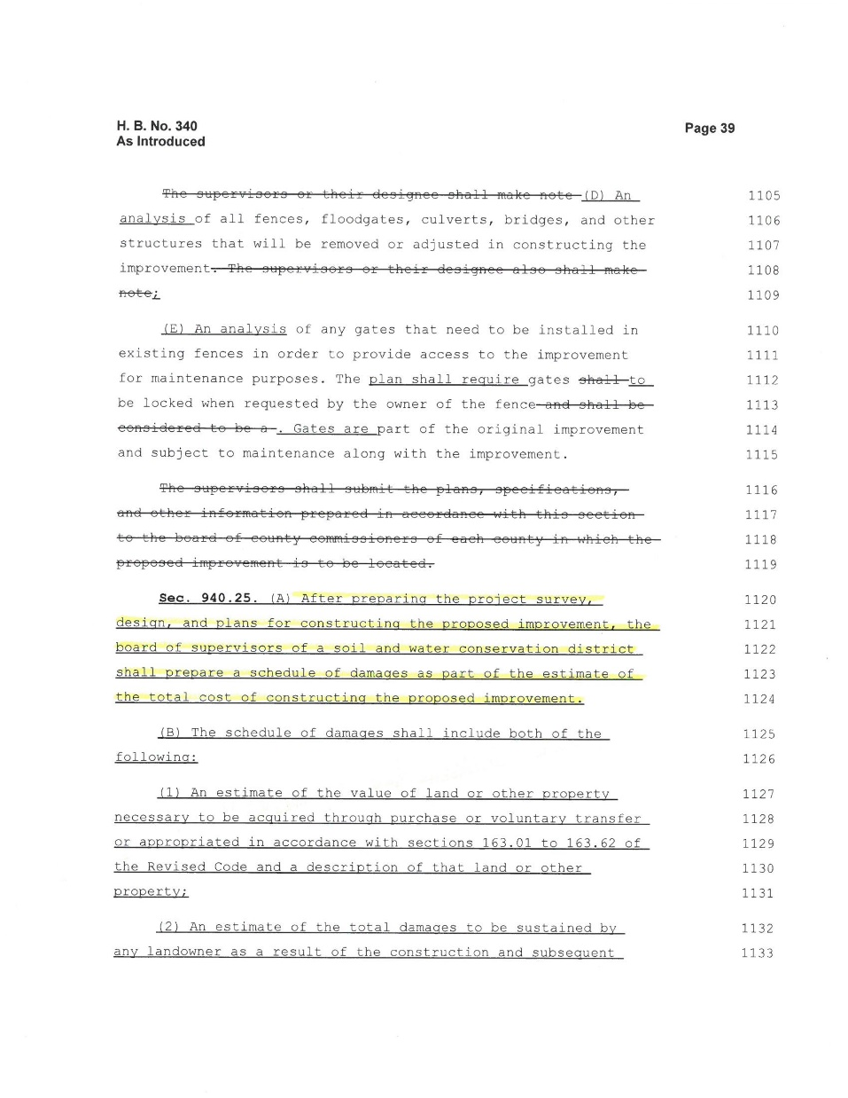
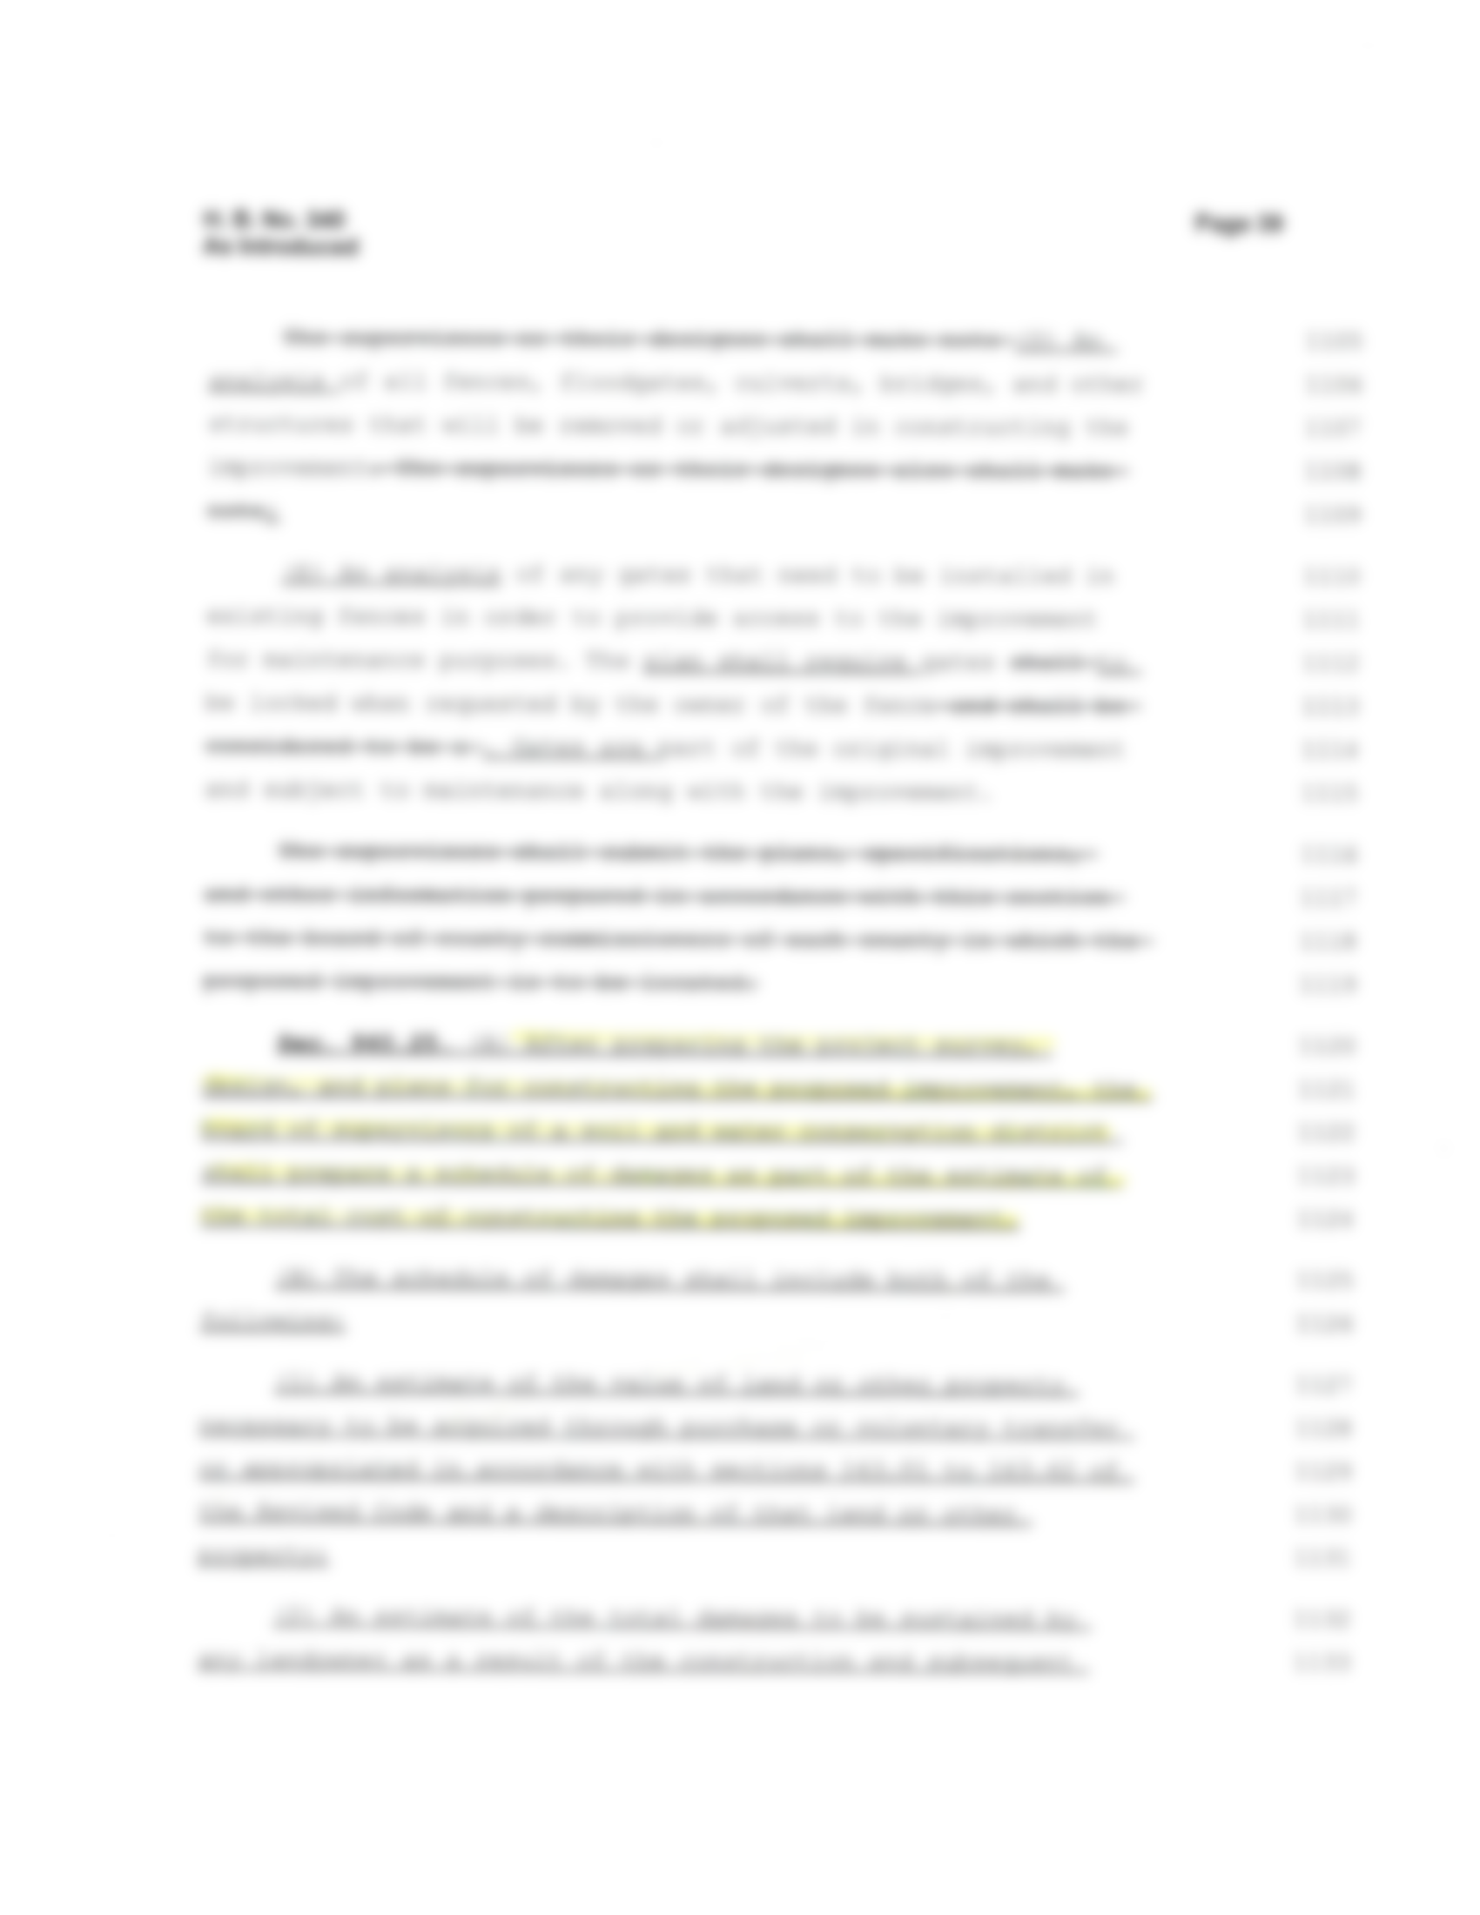
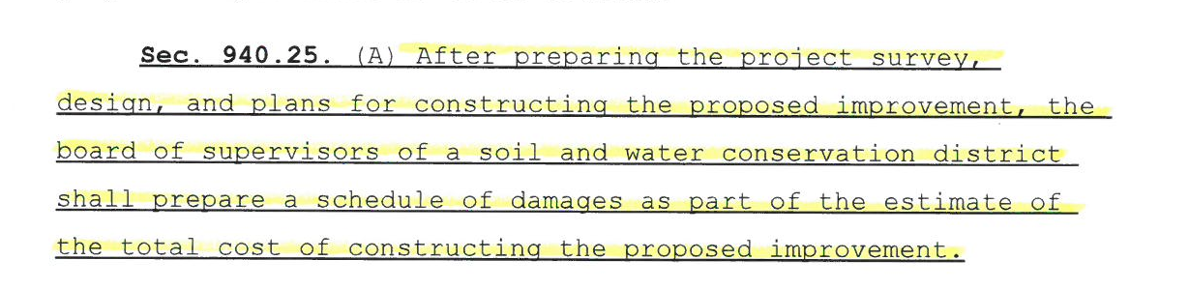

Slide 15
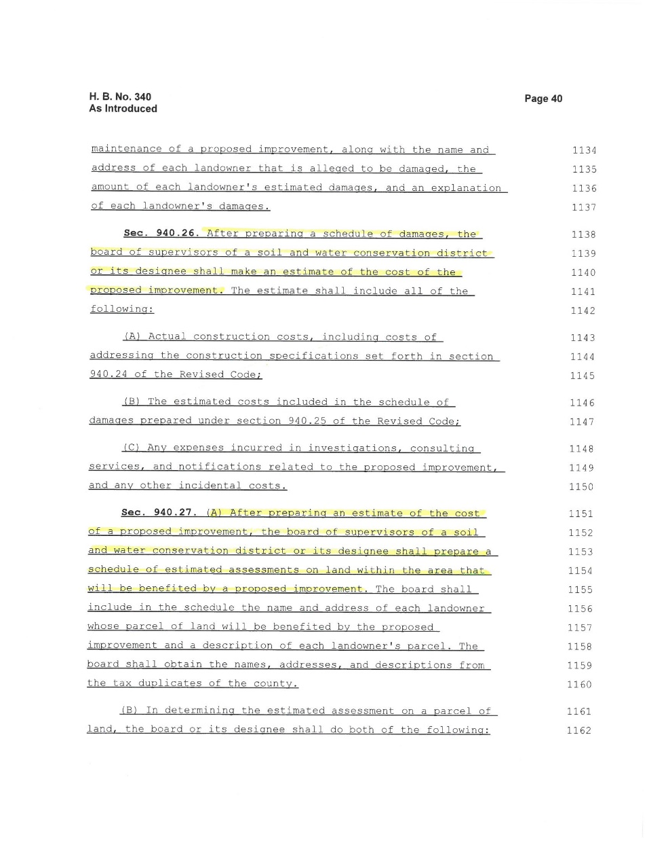
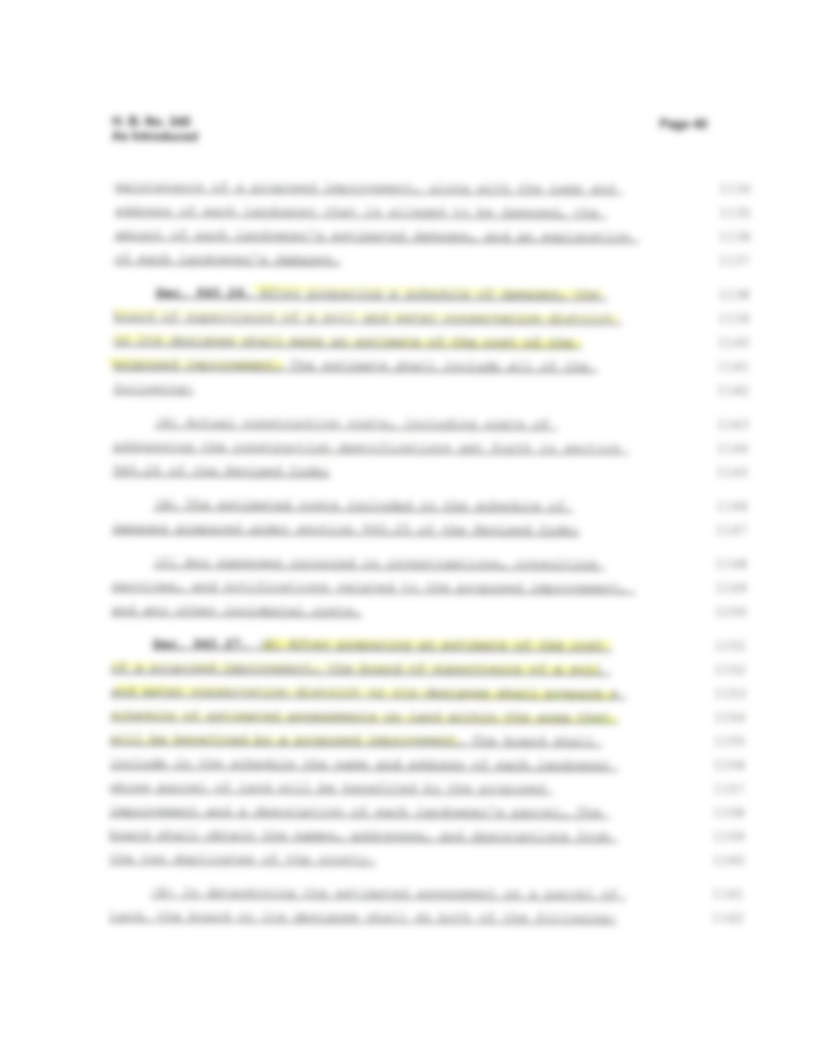
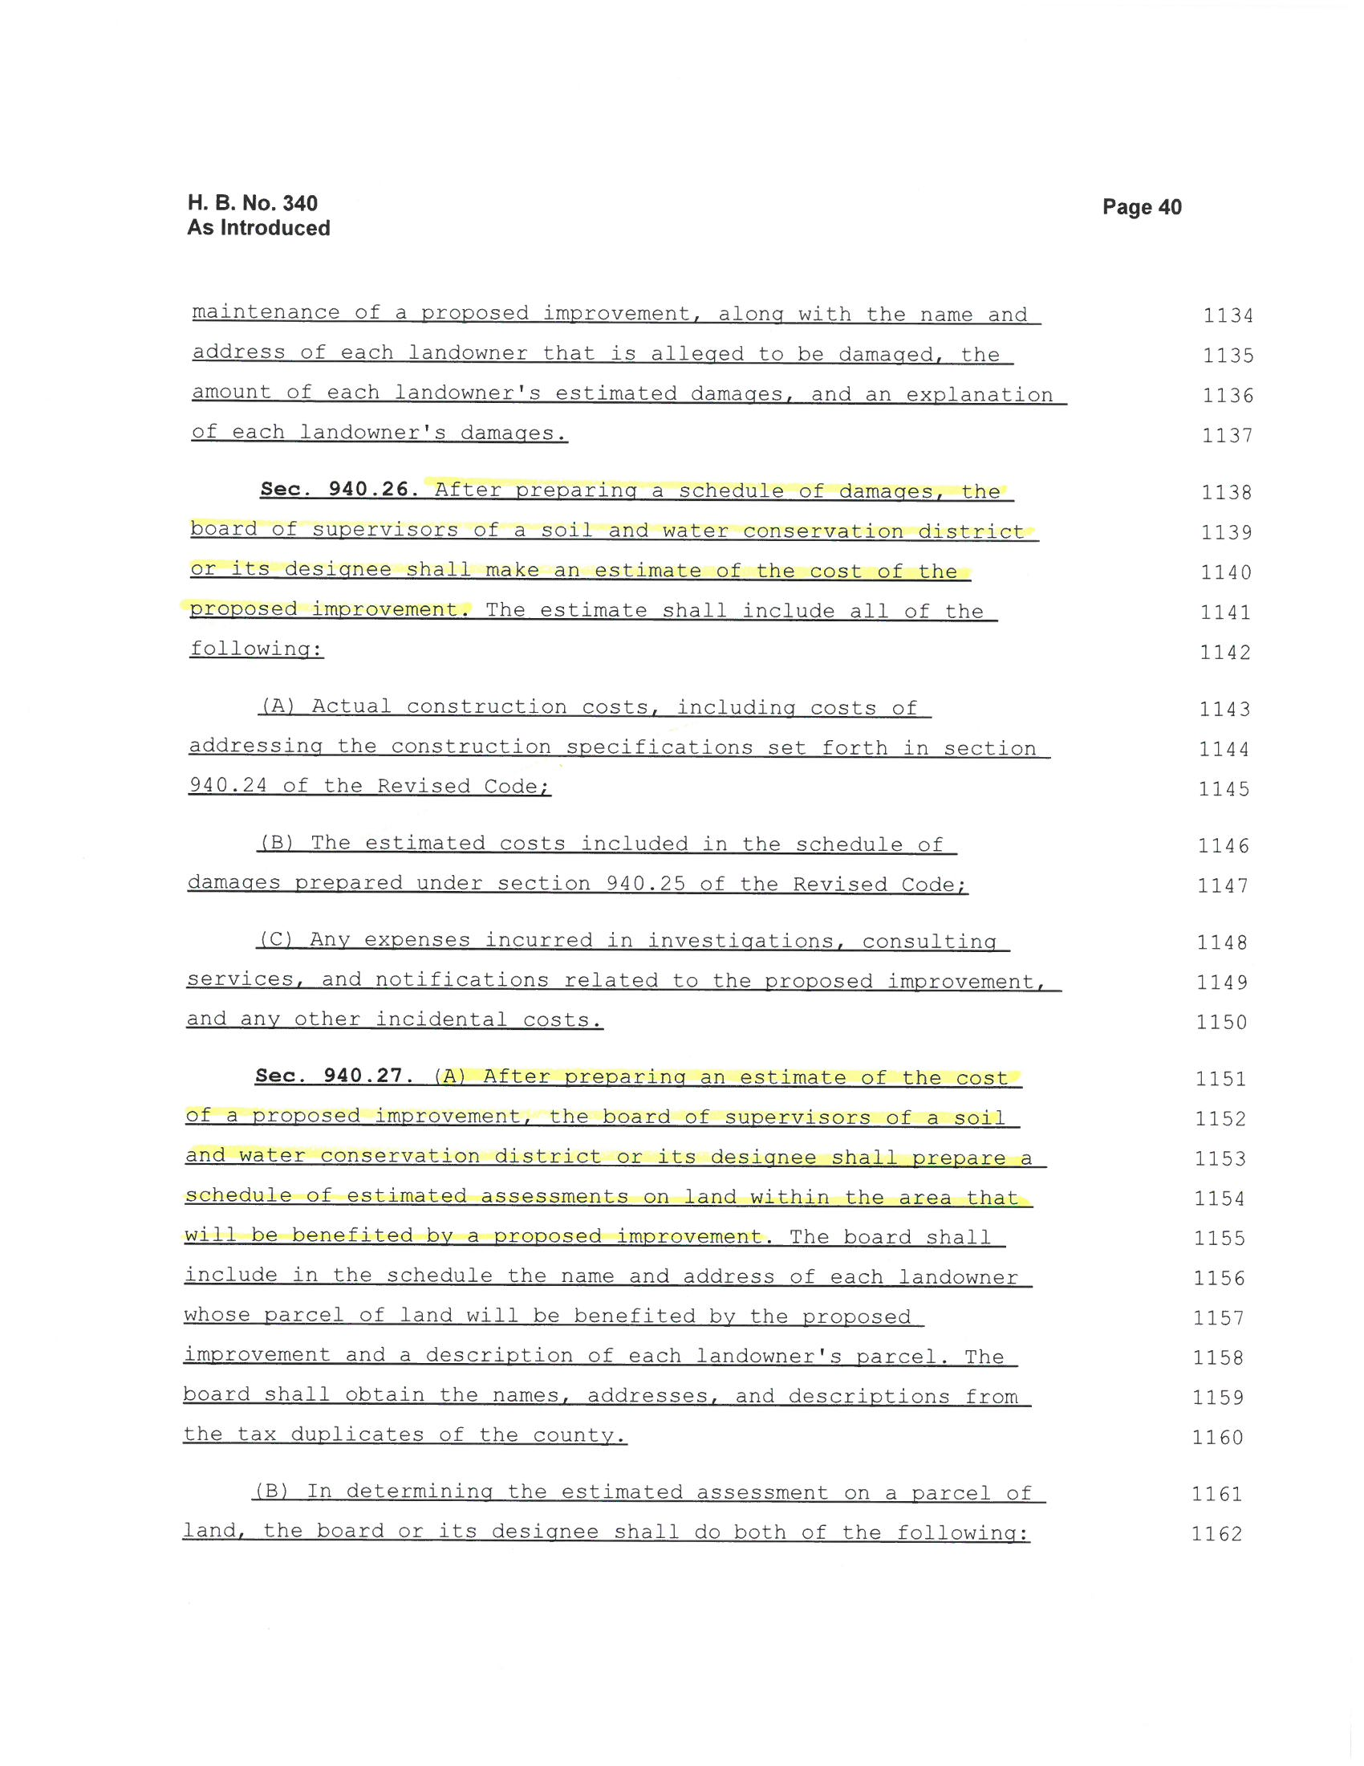

Slide 16
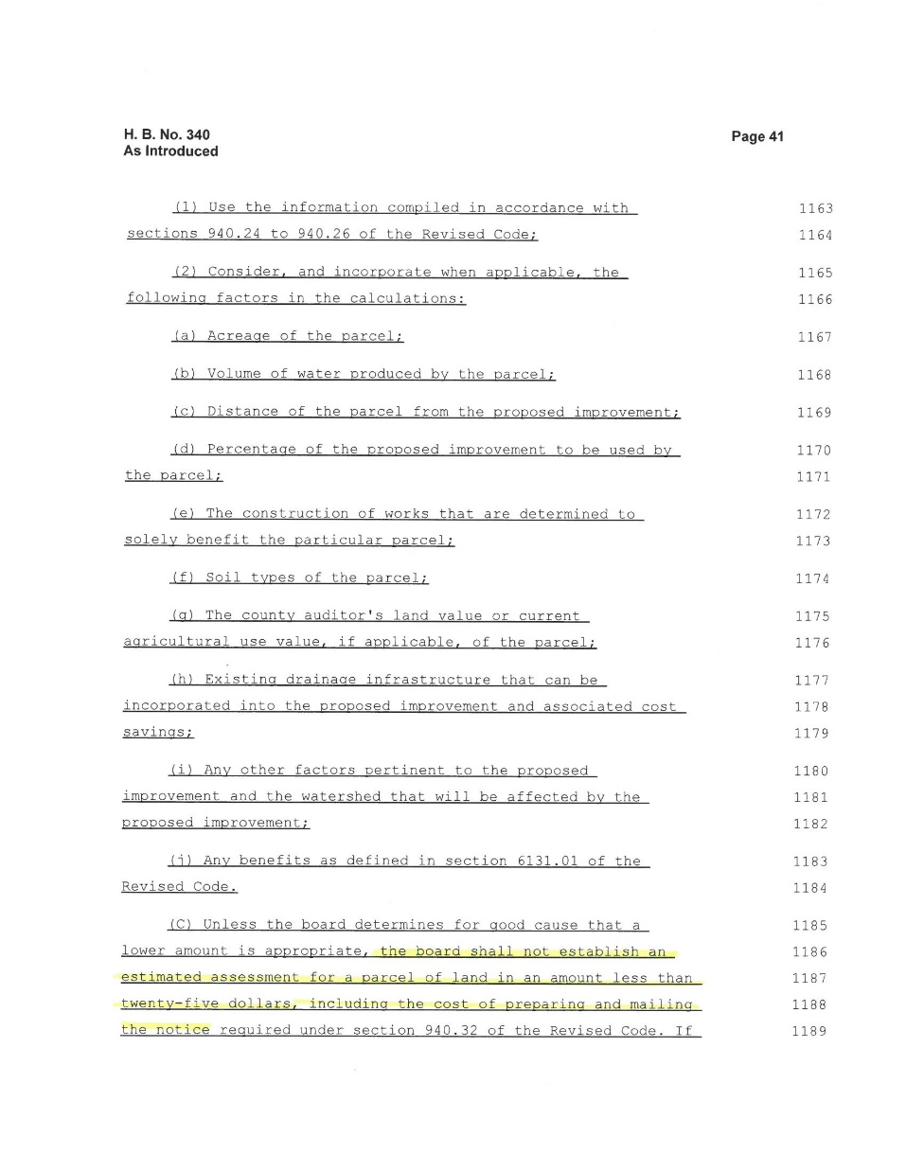



Slide 17
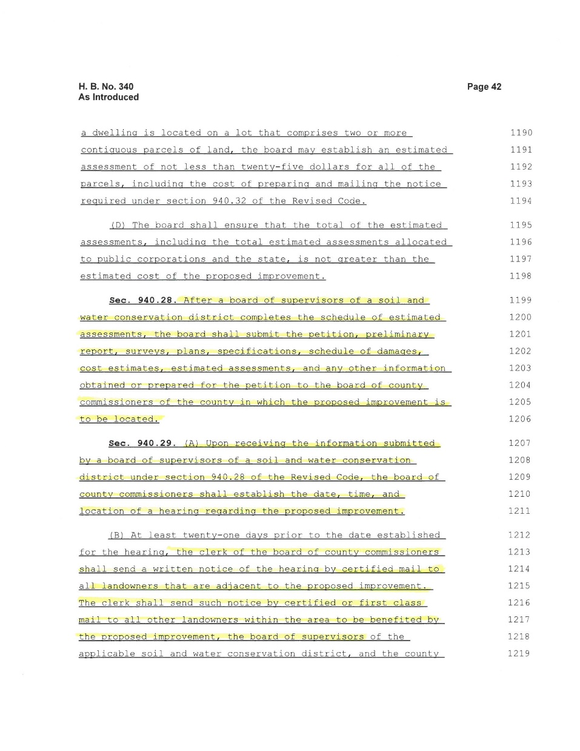
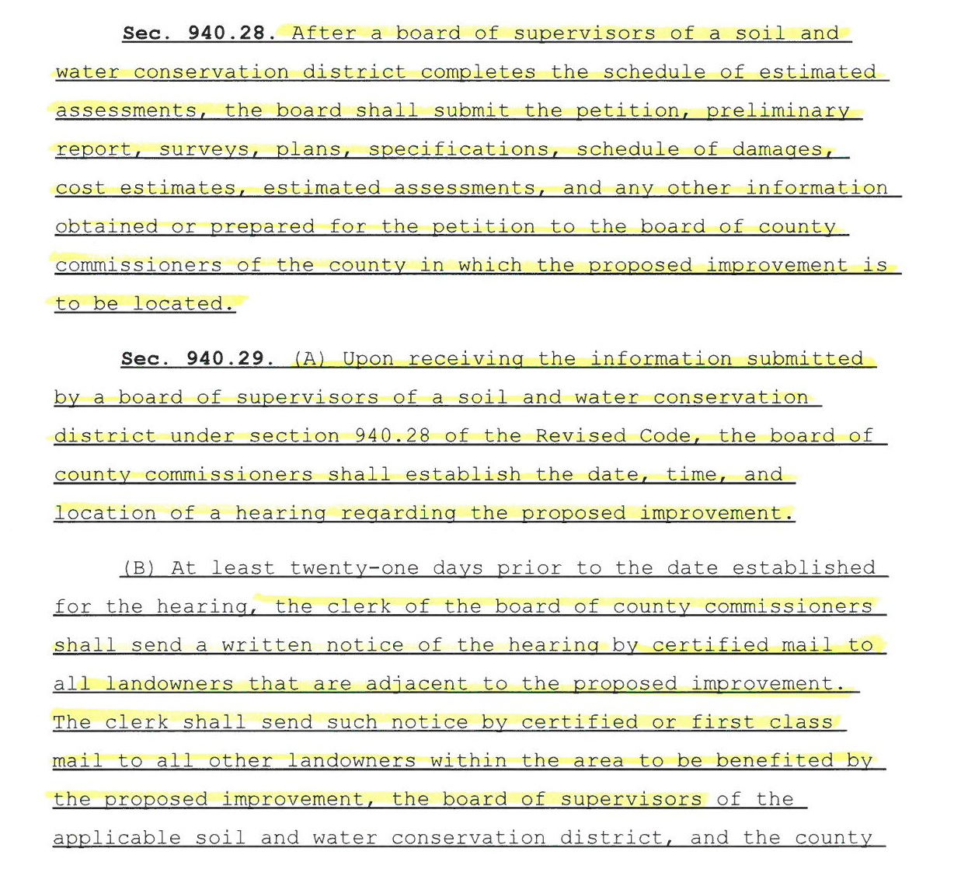

Slide 18
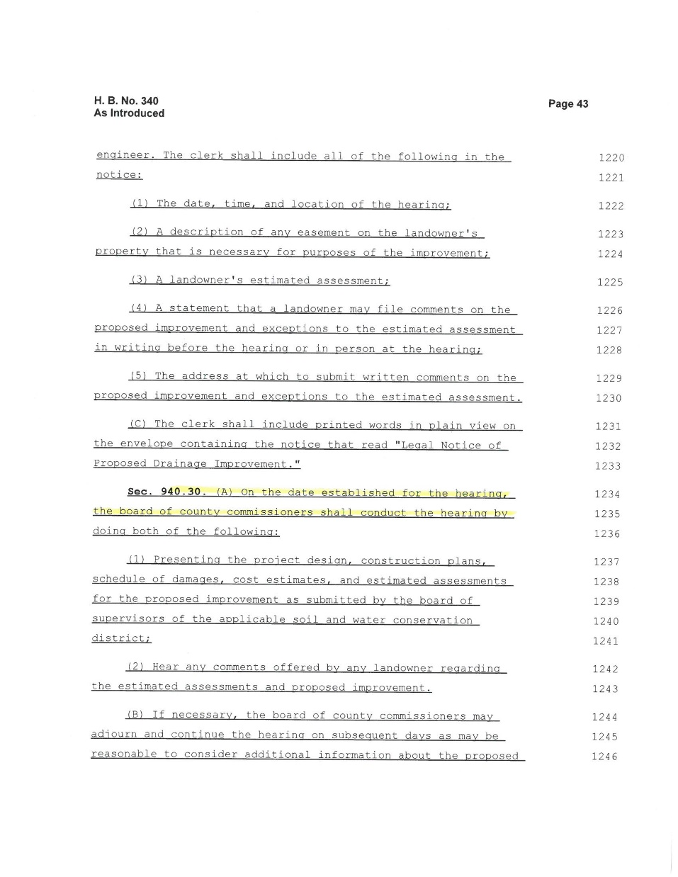

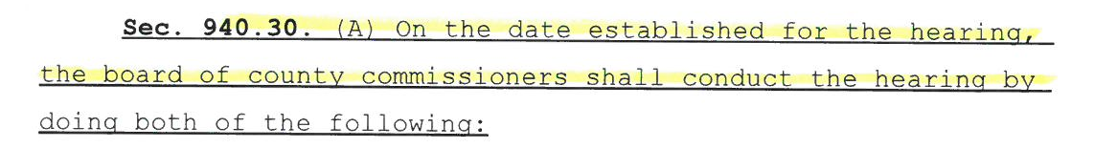

Slide 19
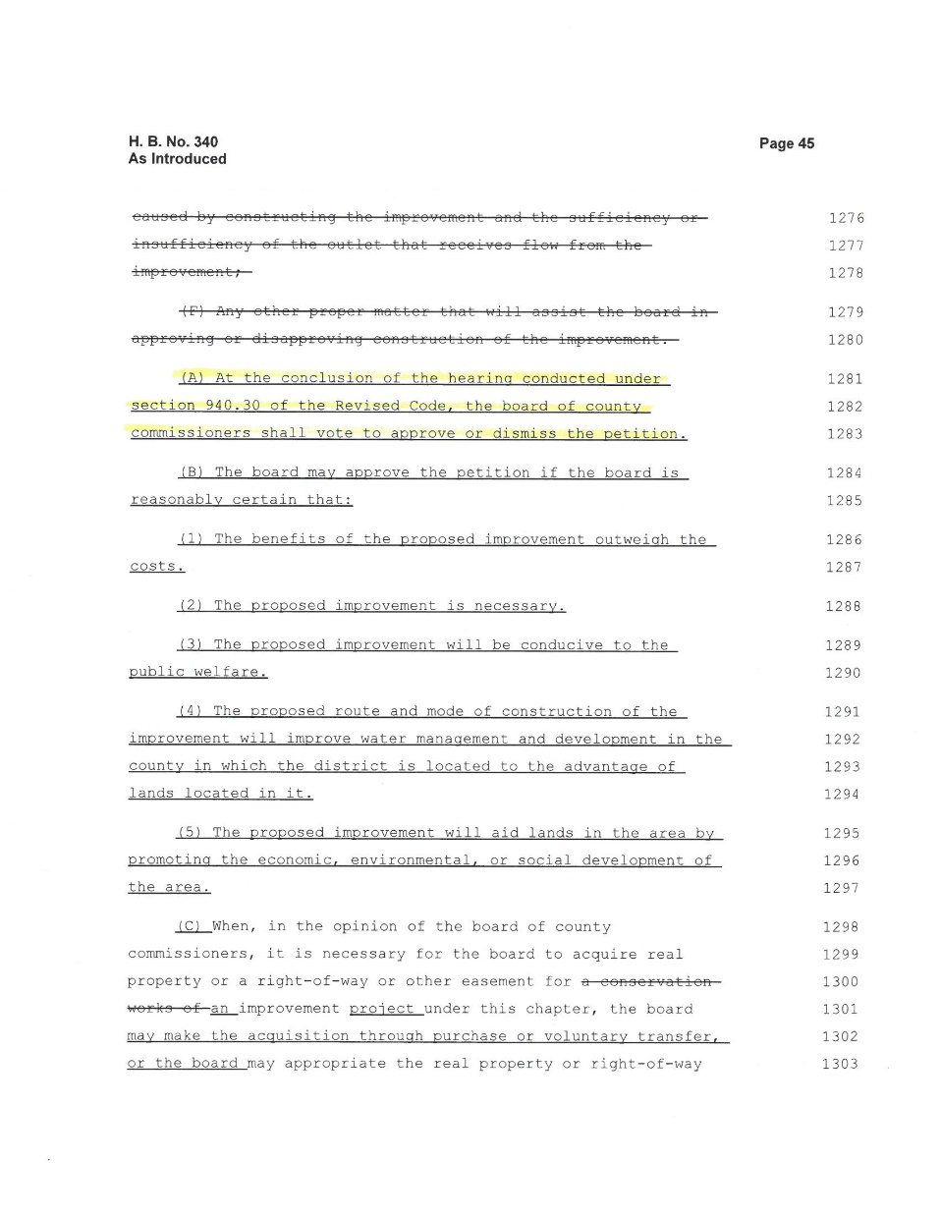
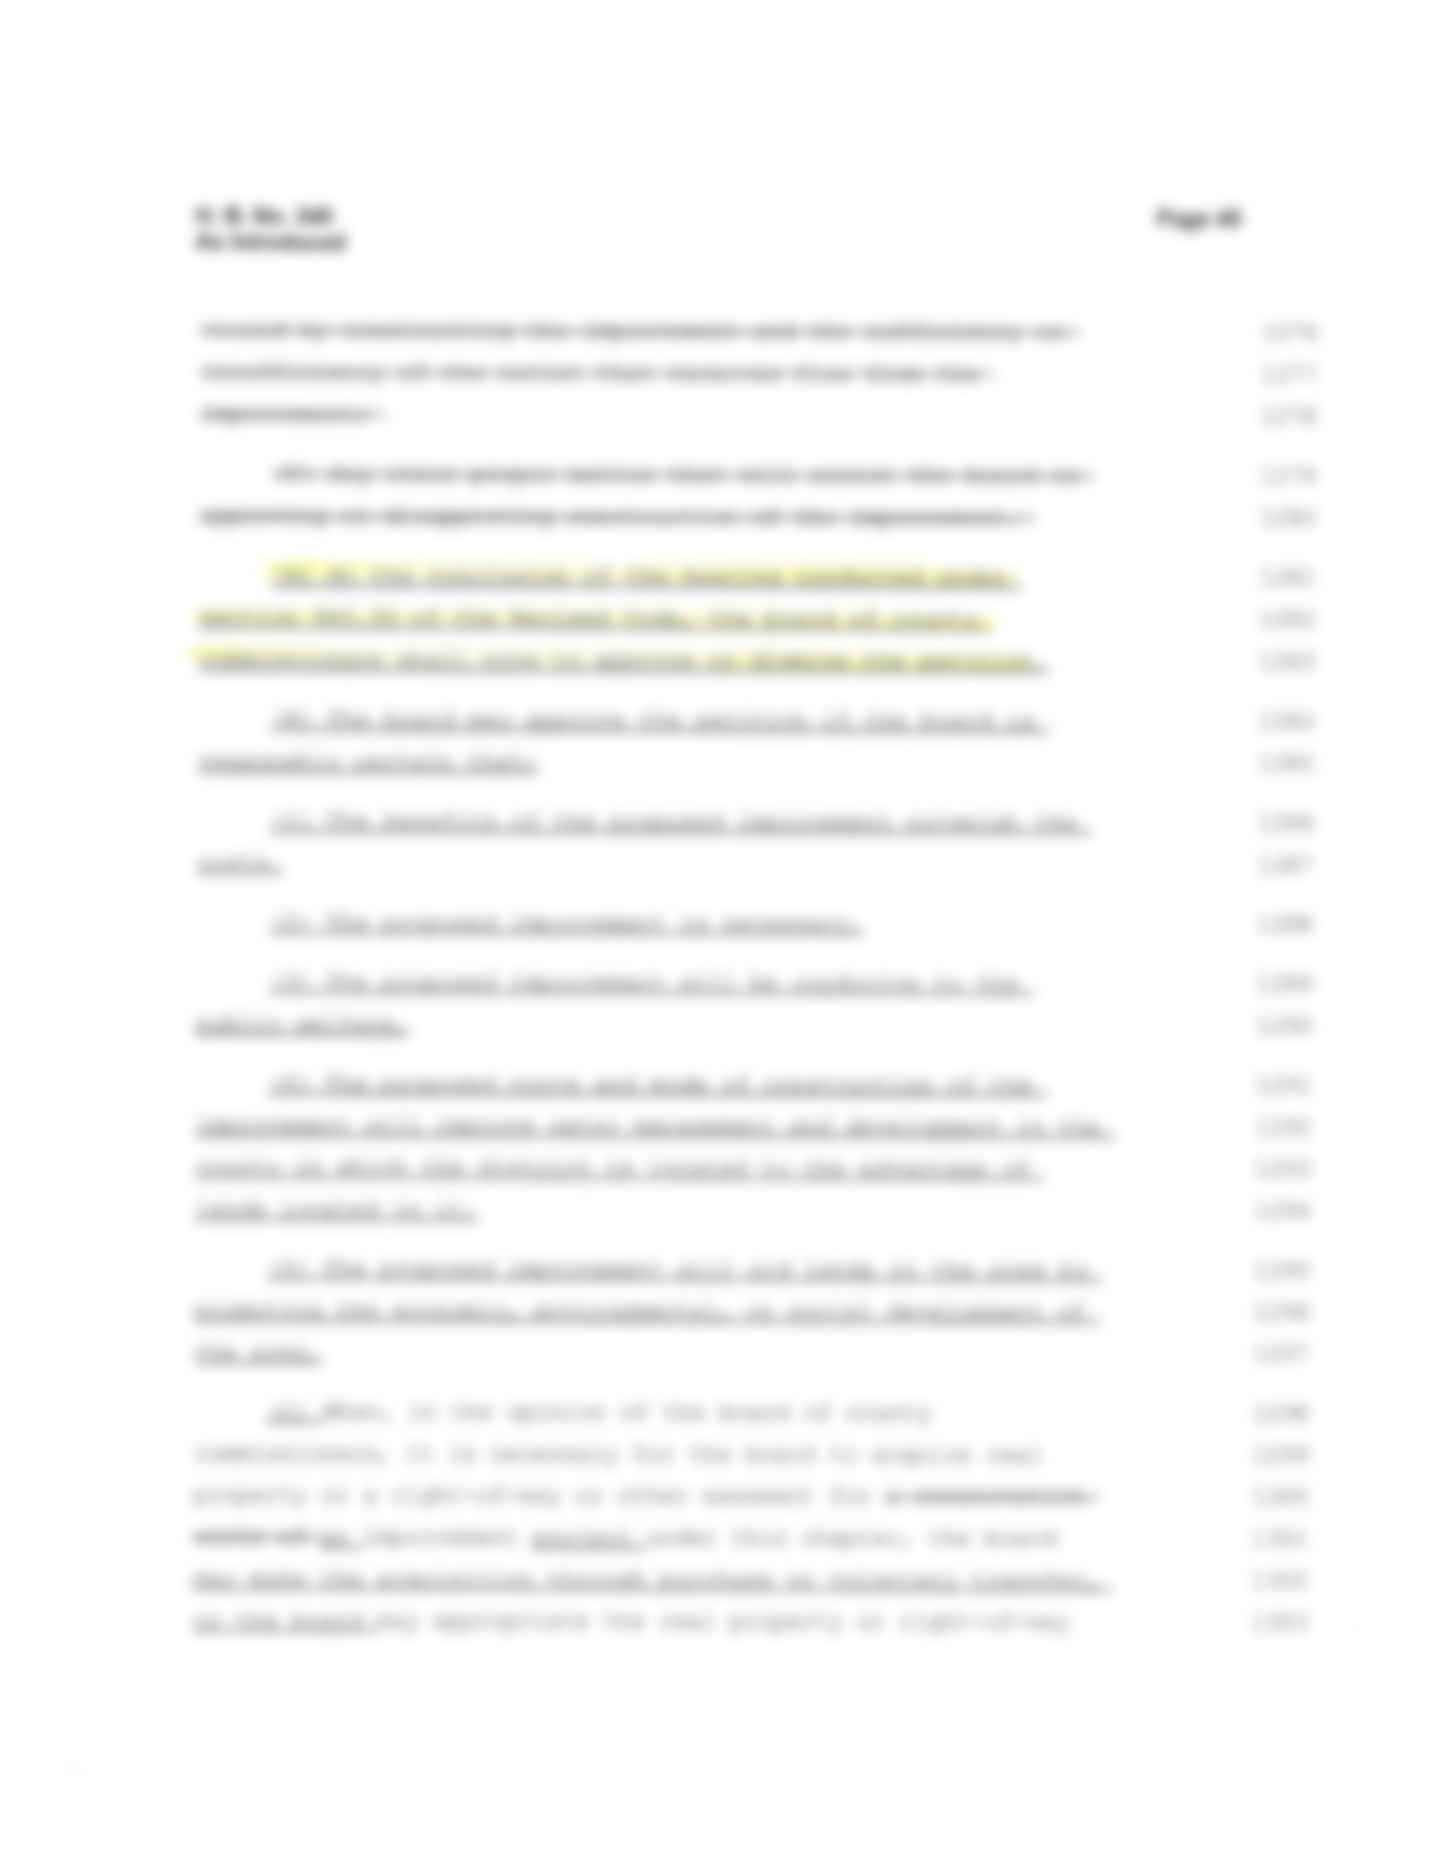


Slide 20
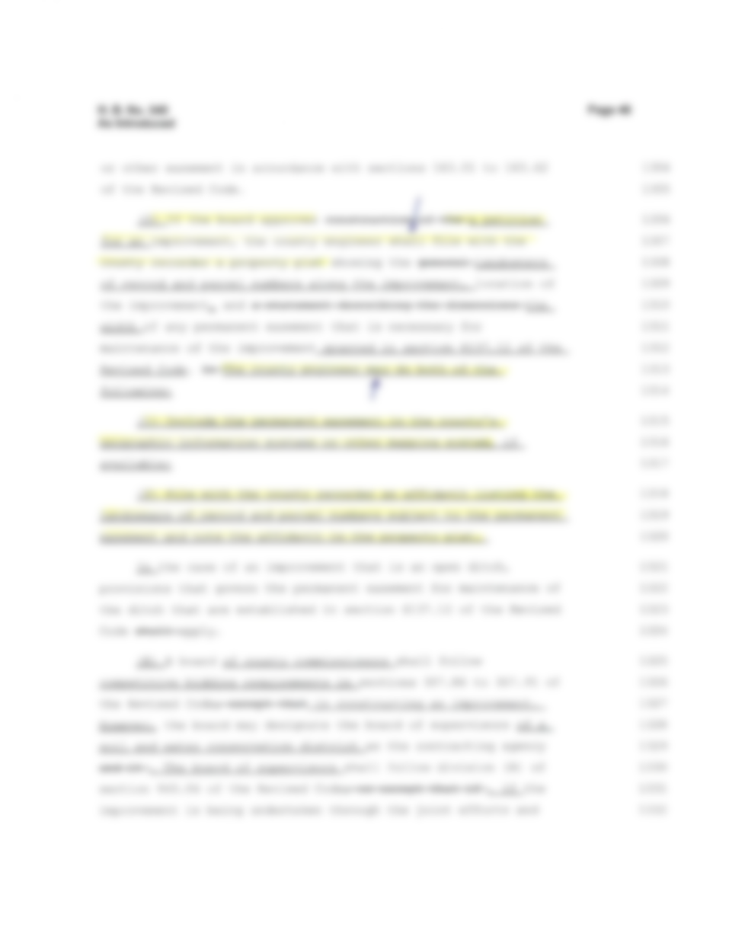
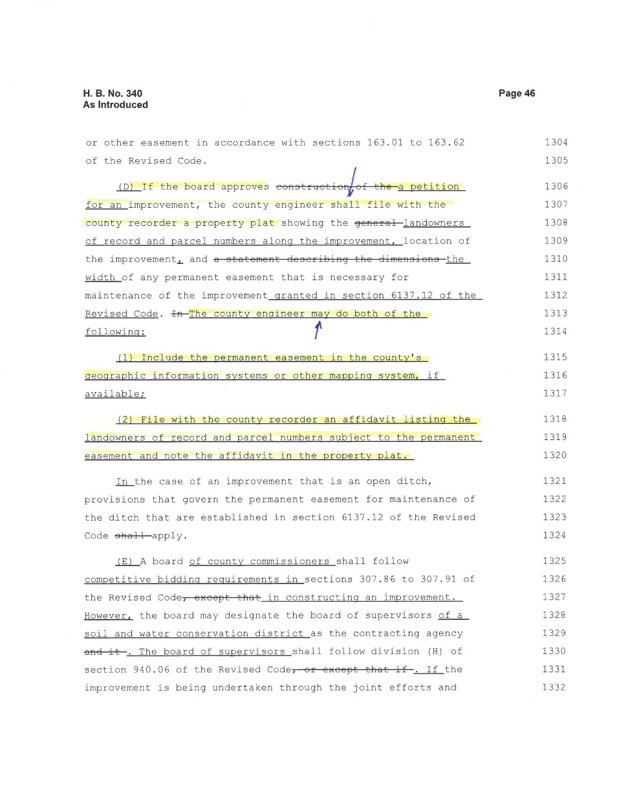
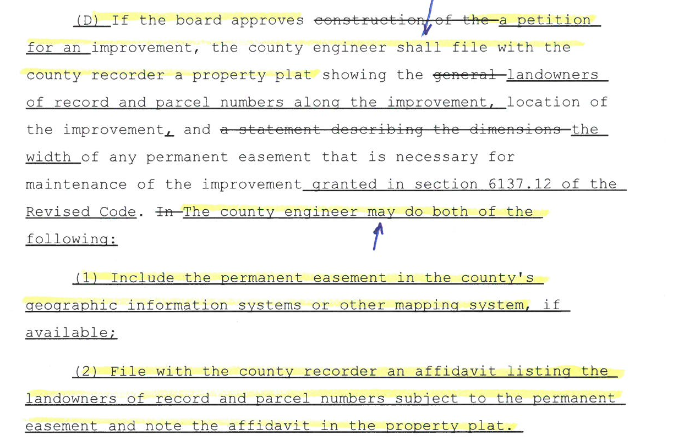

Slide 21
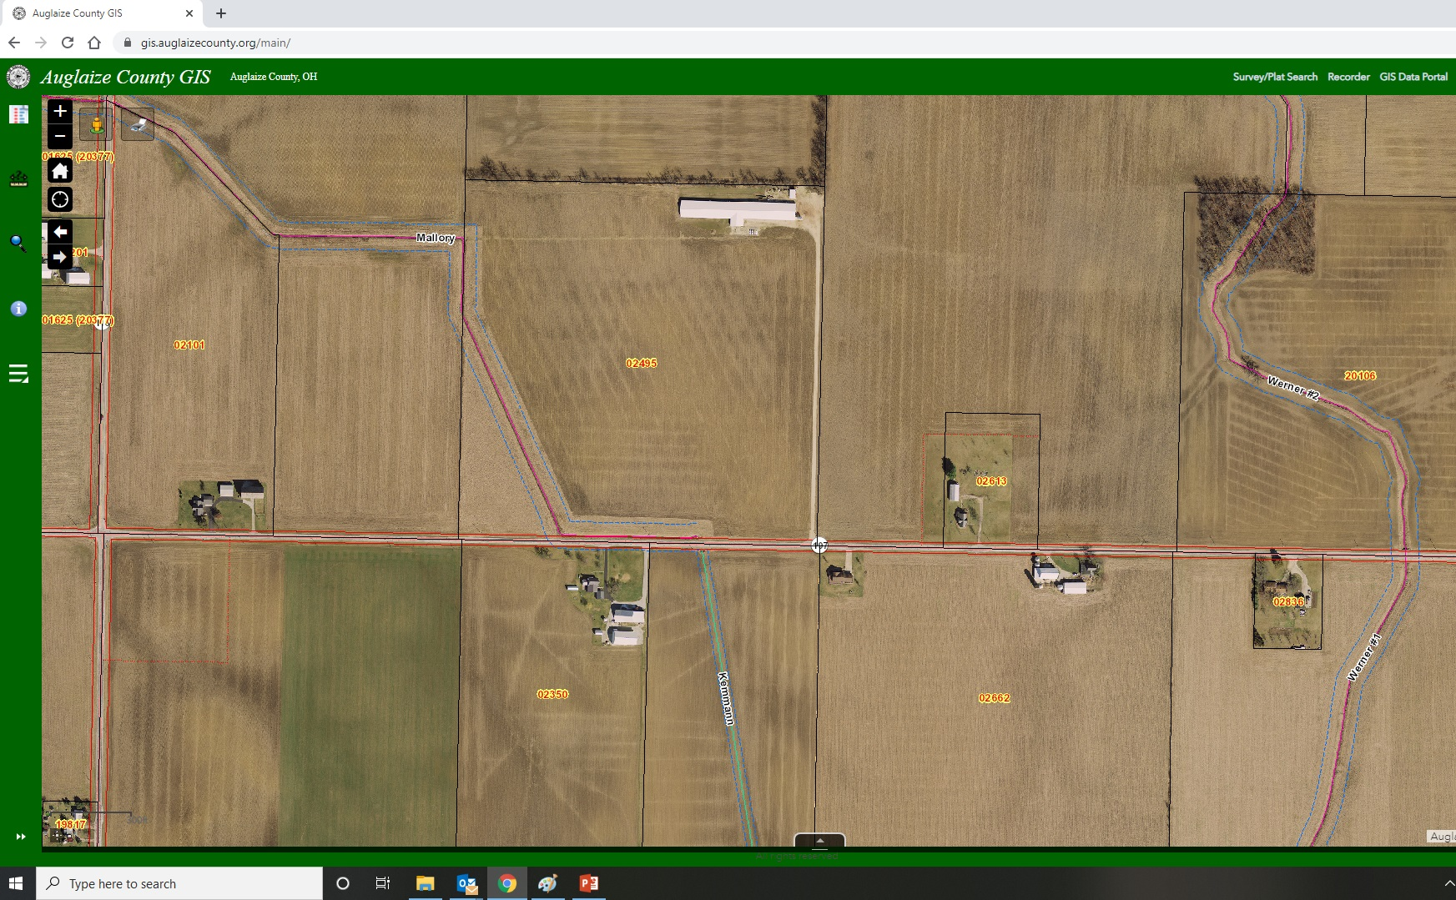

Slide 22
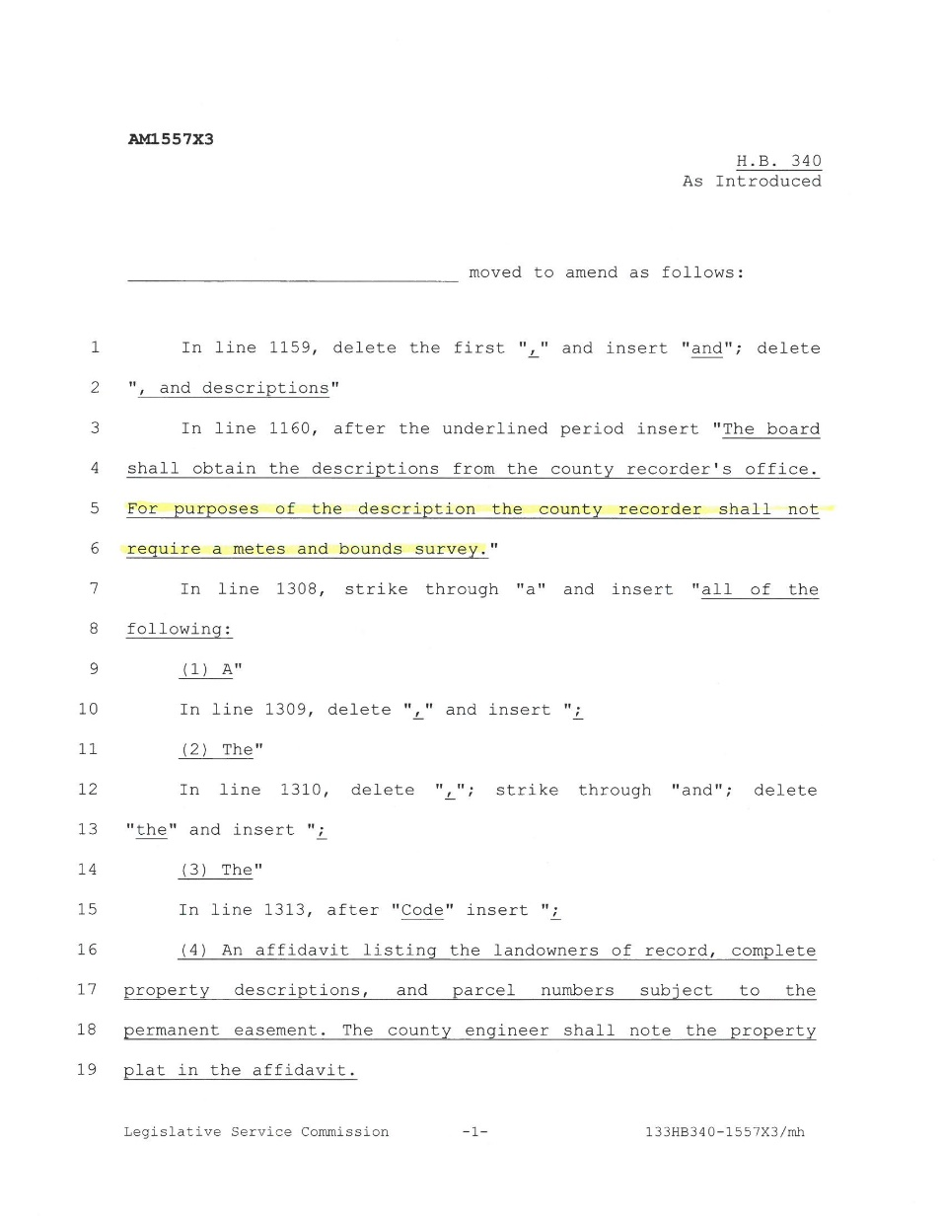
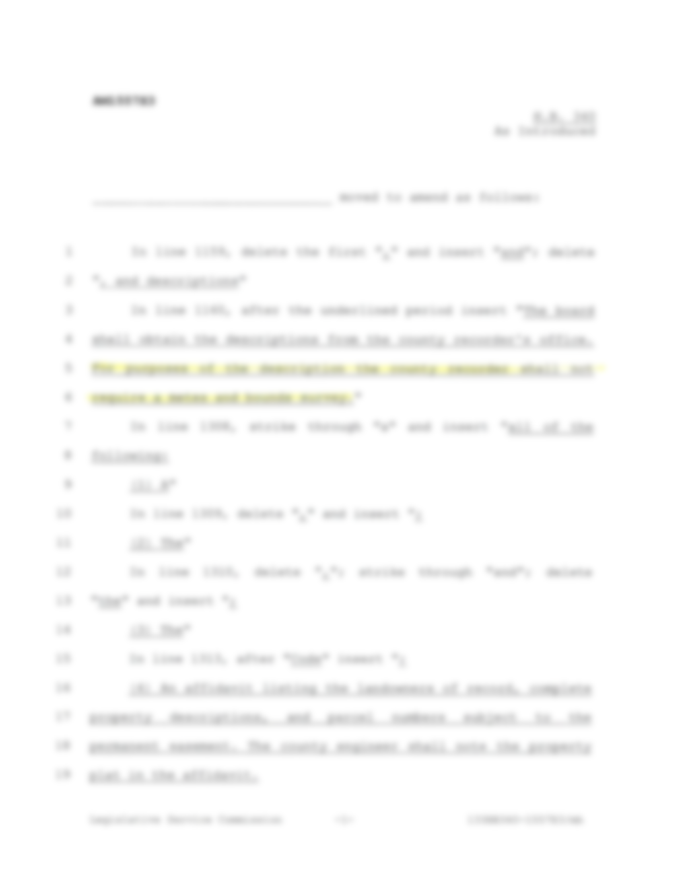
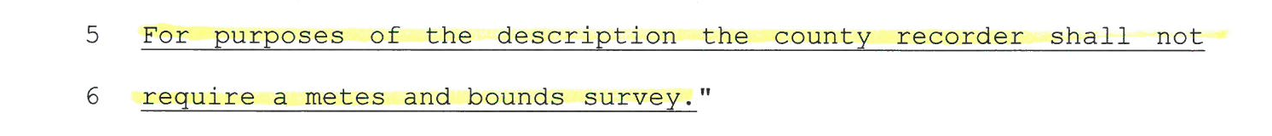

Slide 23
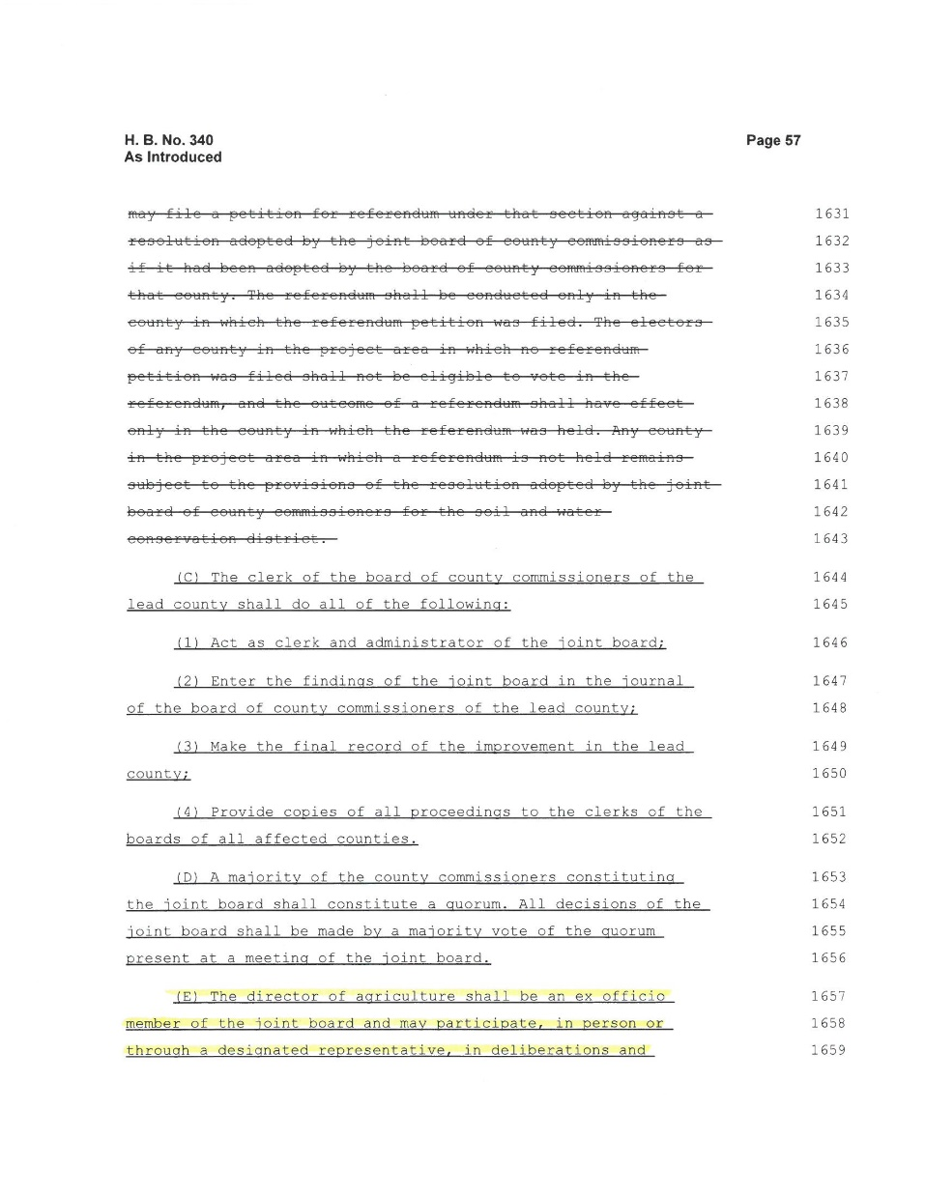
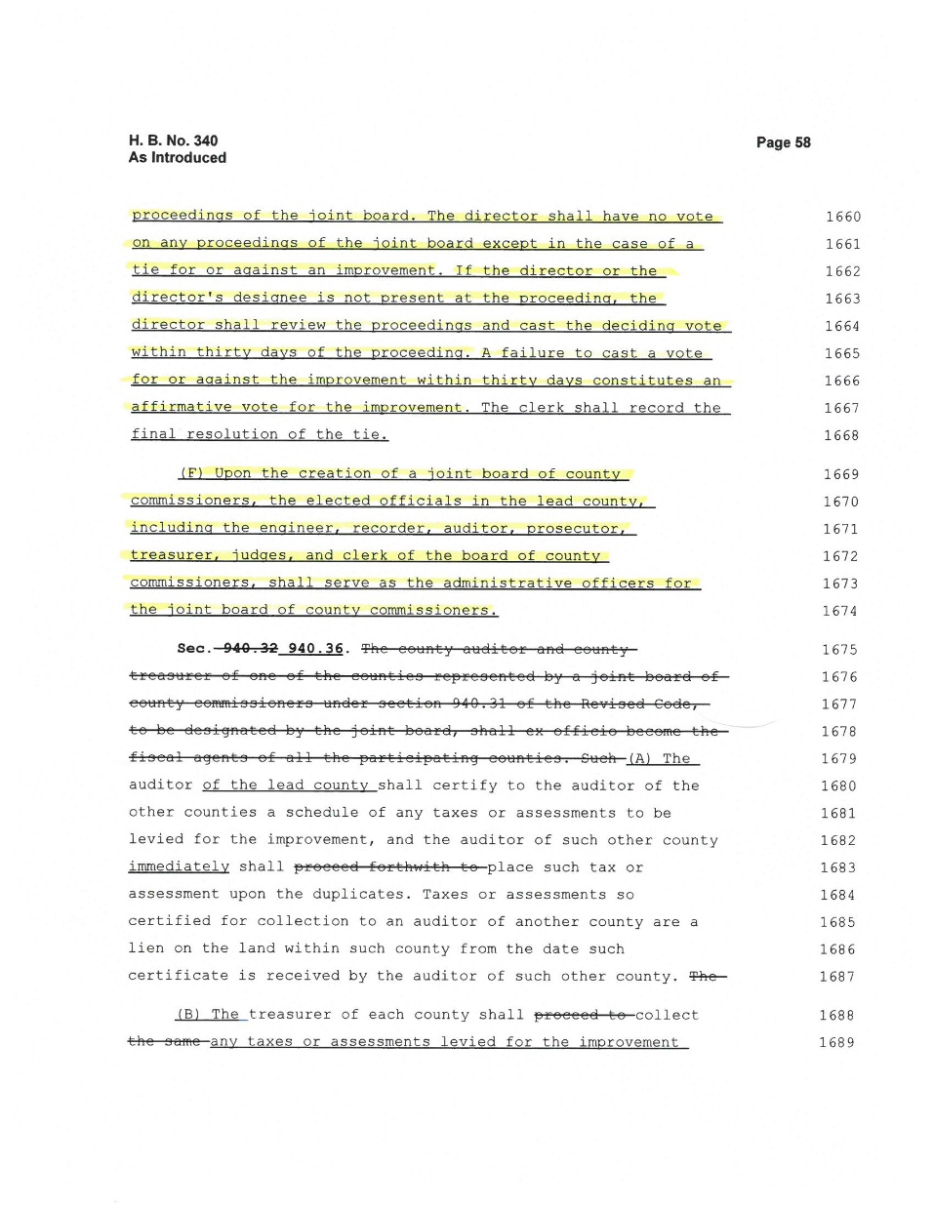

Slide 24
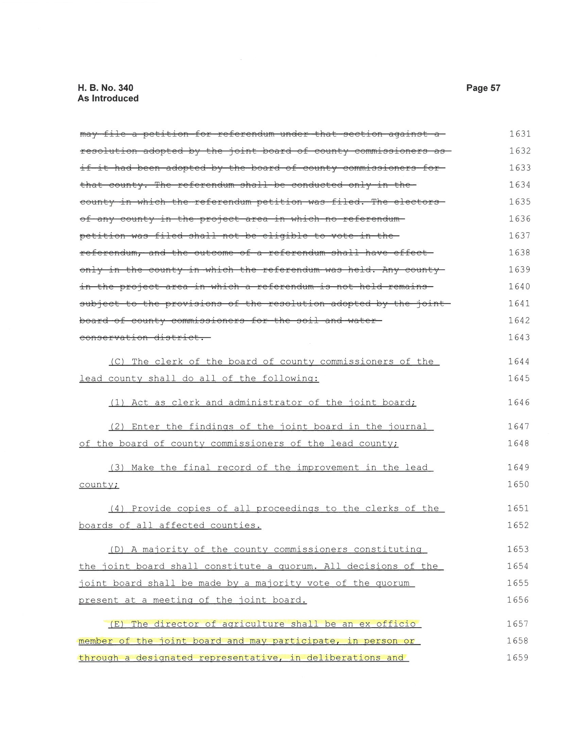
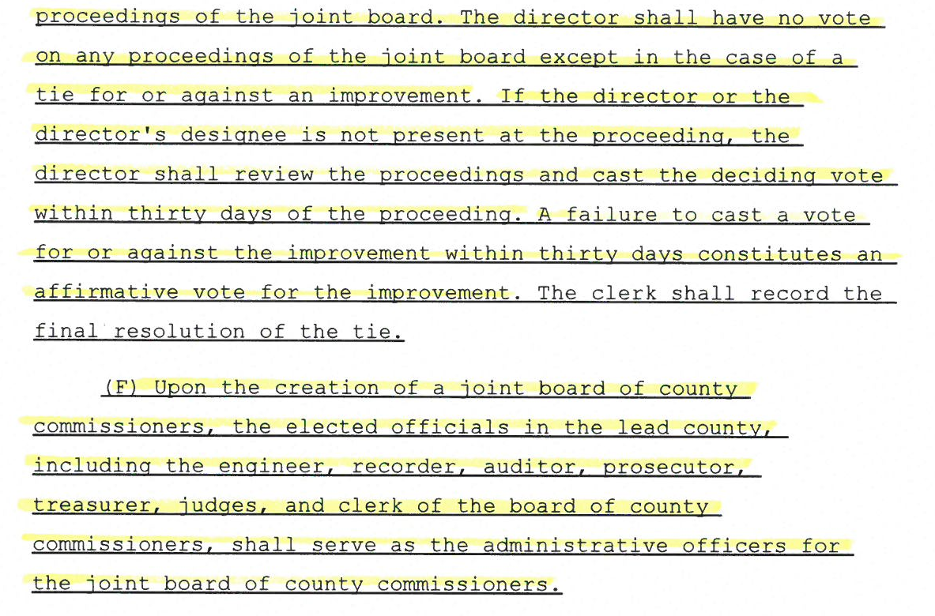

Slide 25
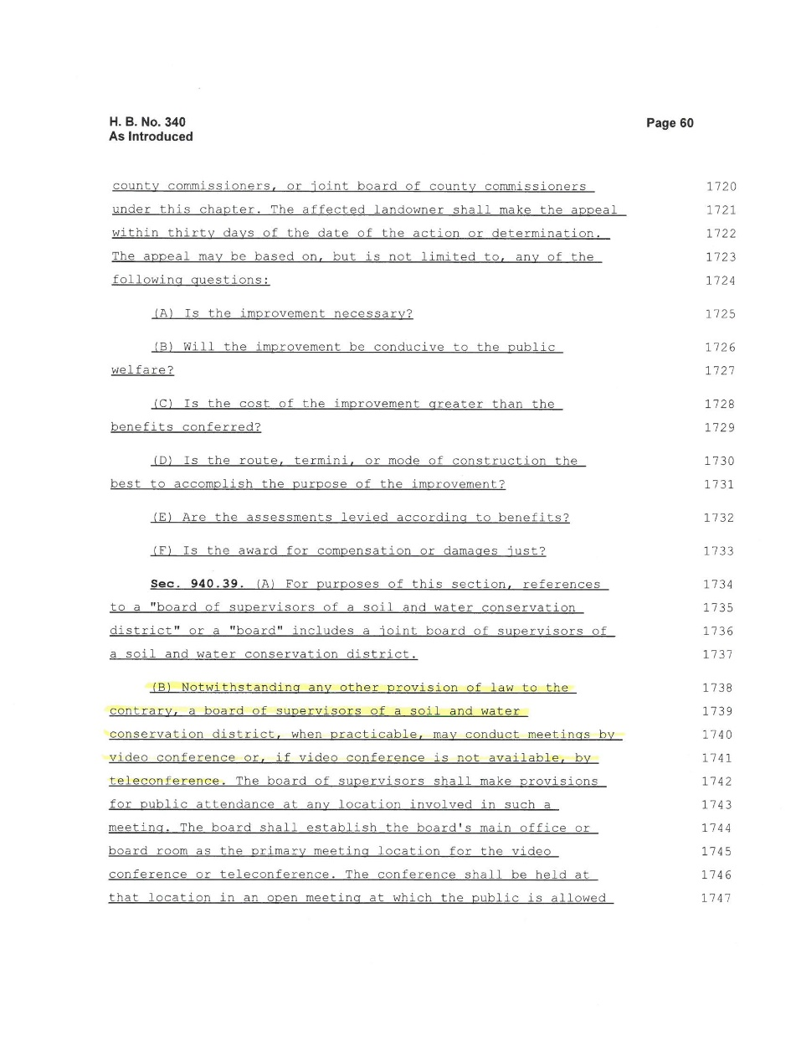
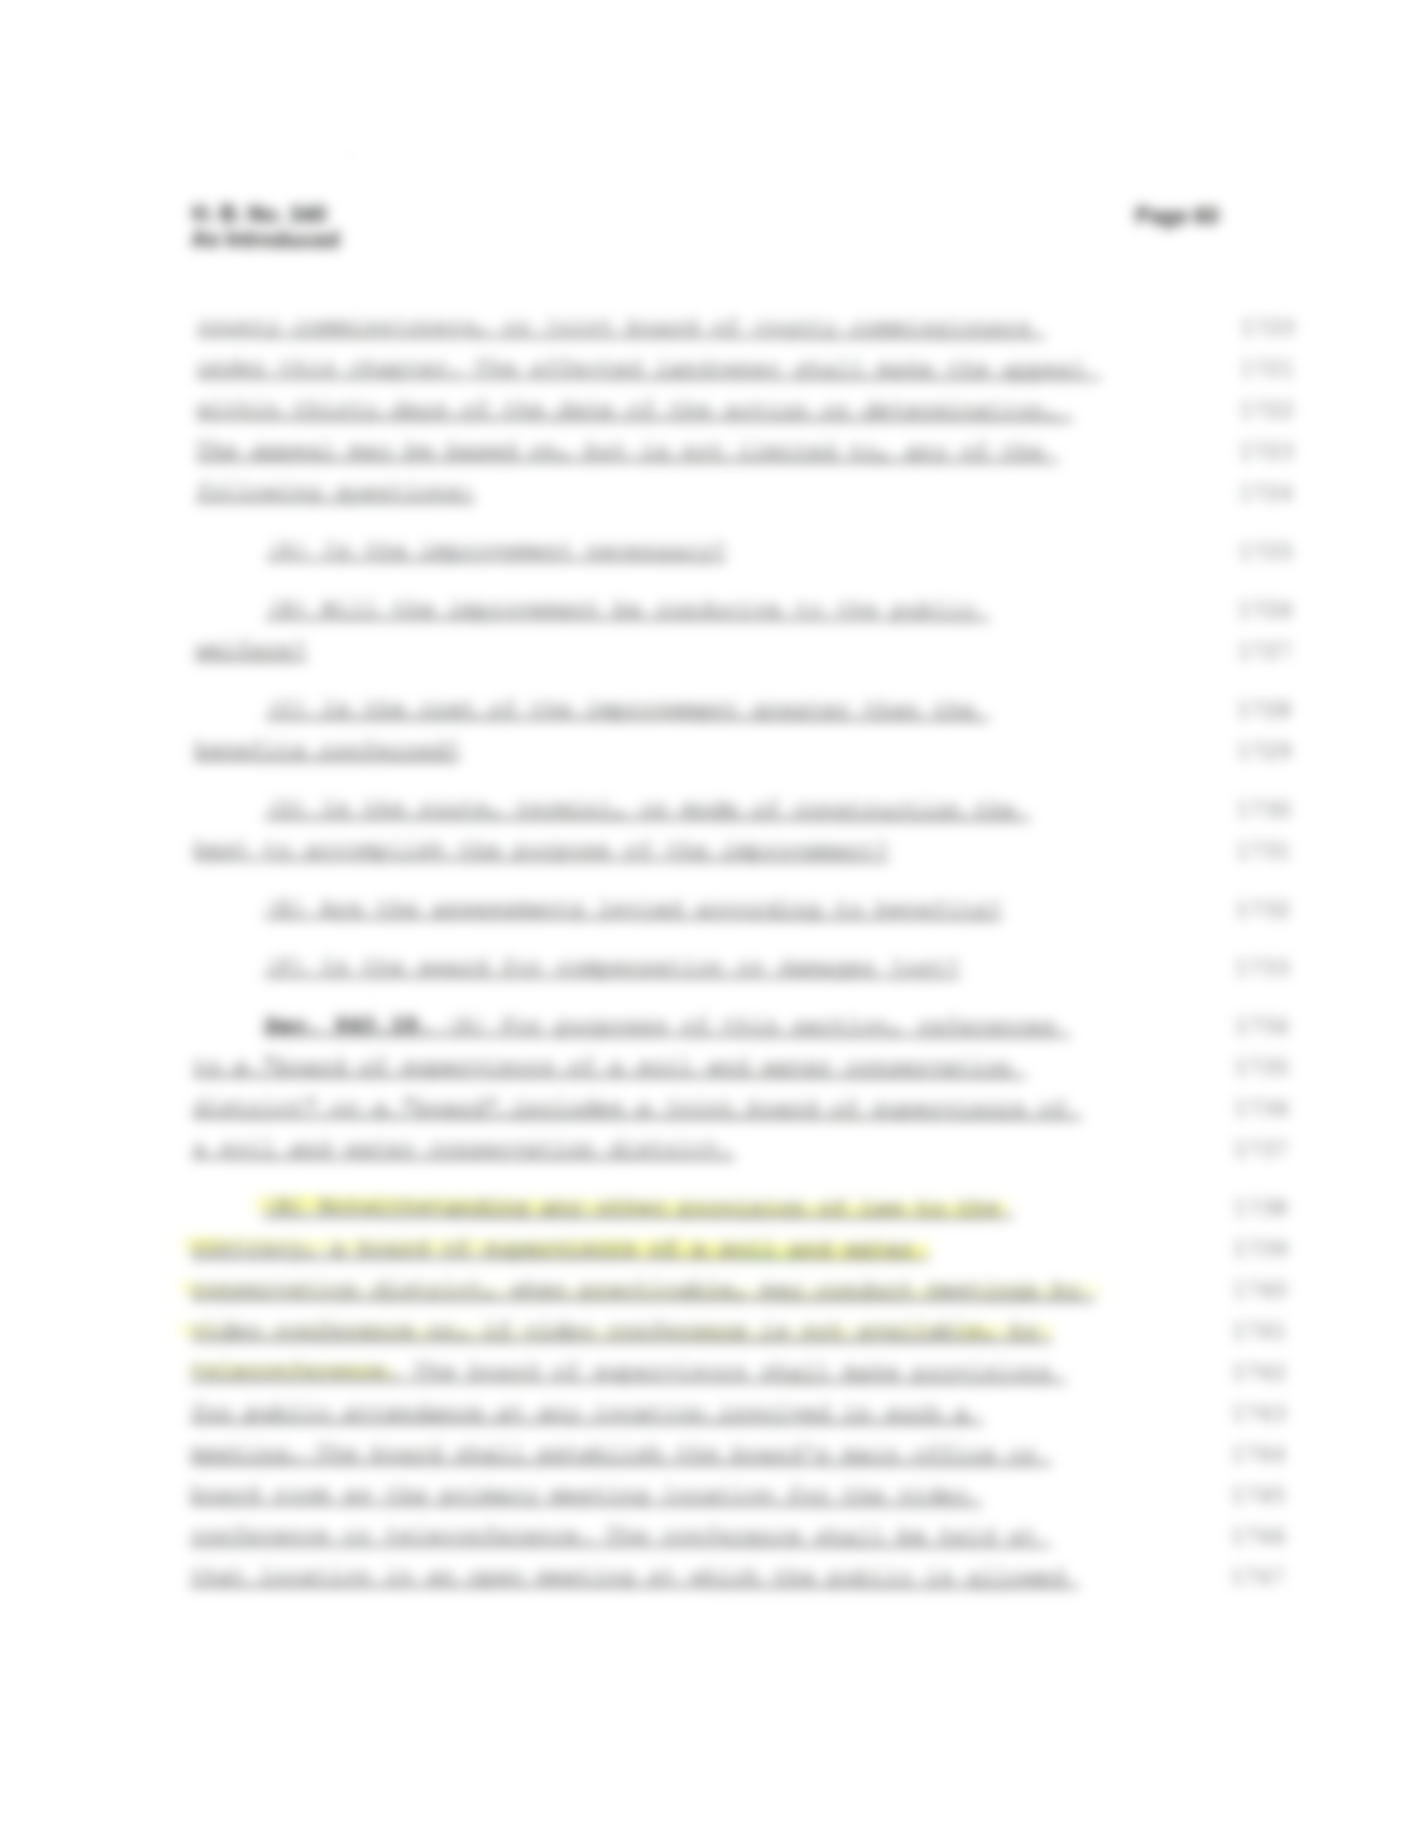


Slide 26
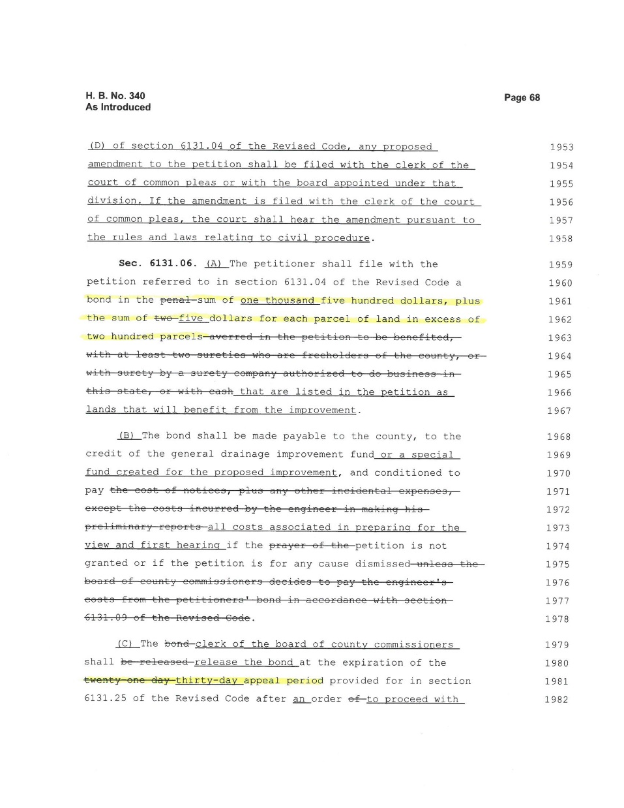
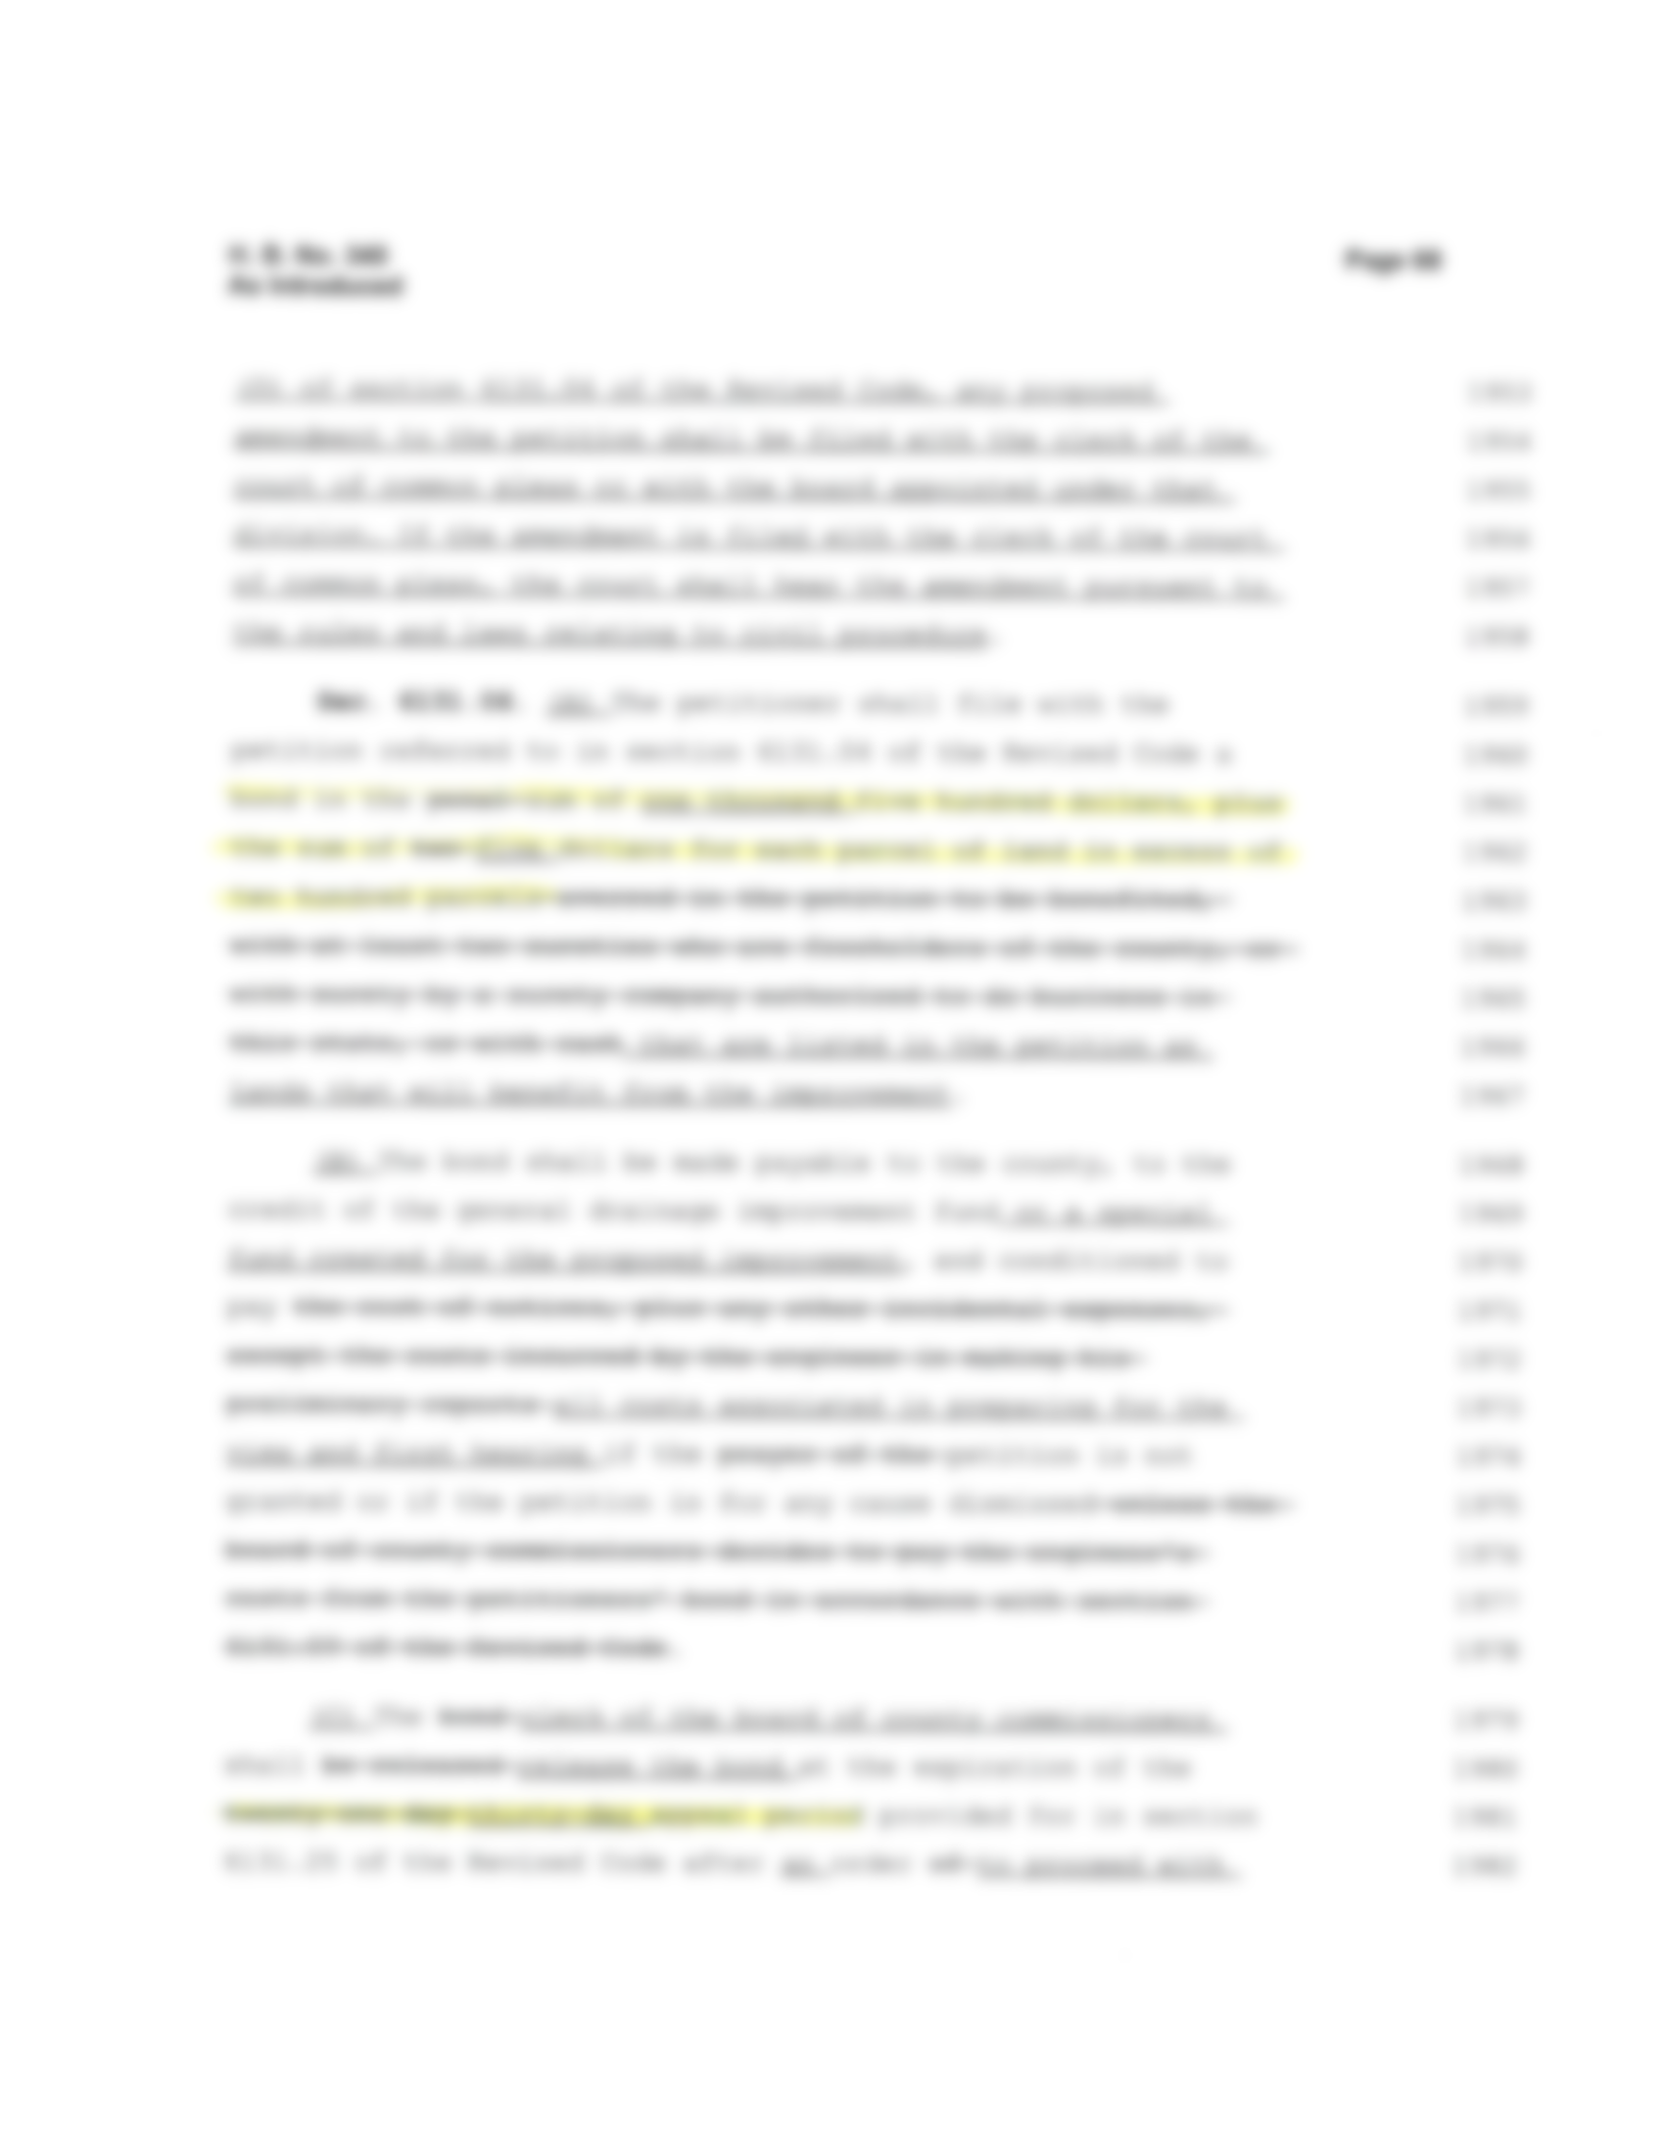
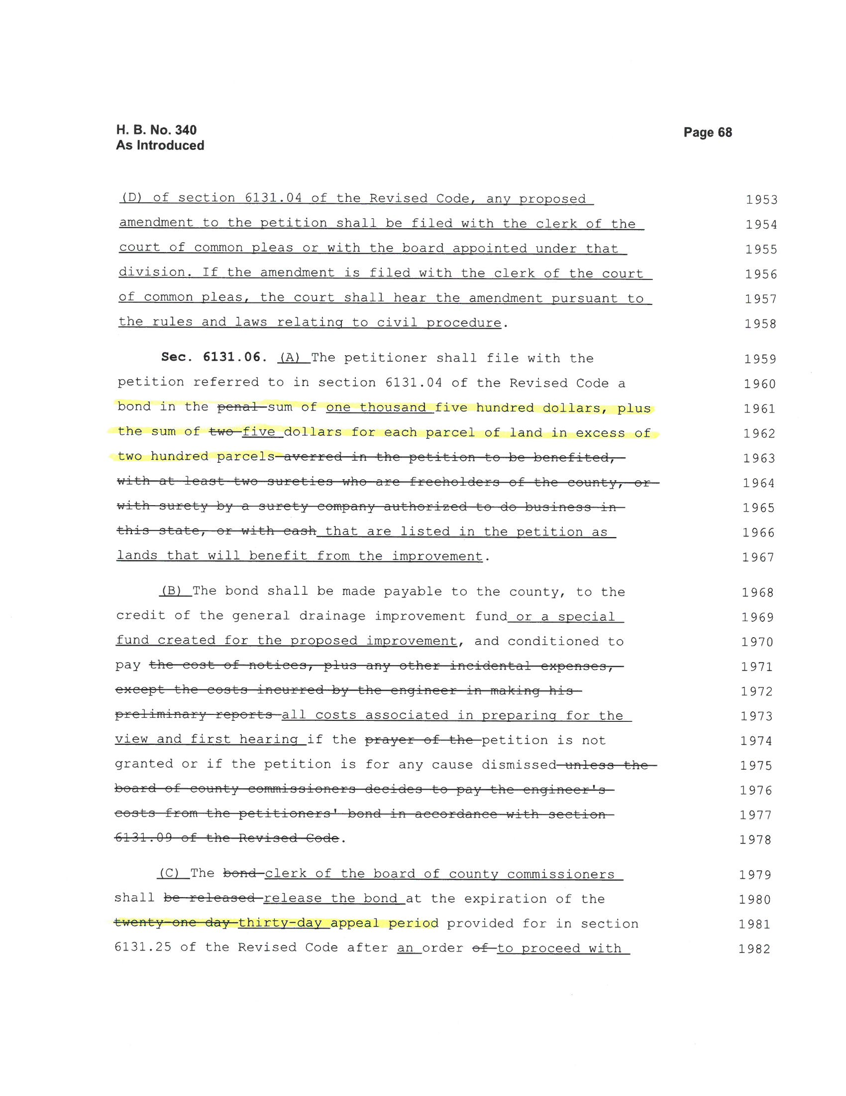

Slide 27
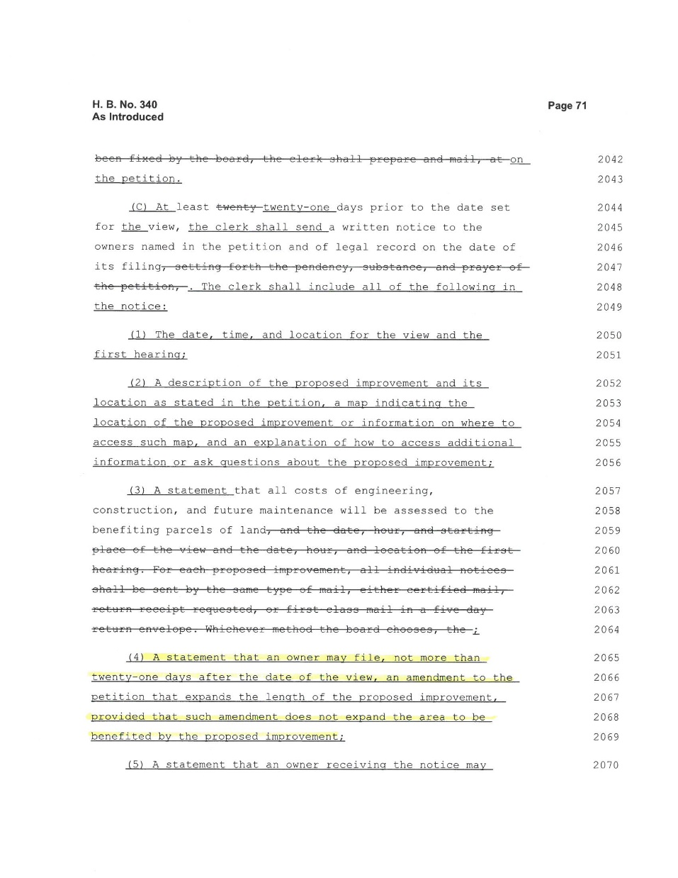
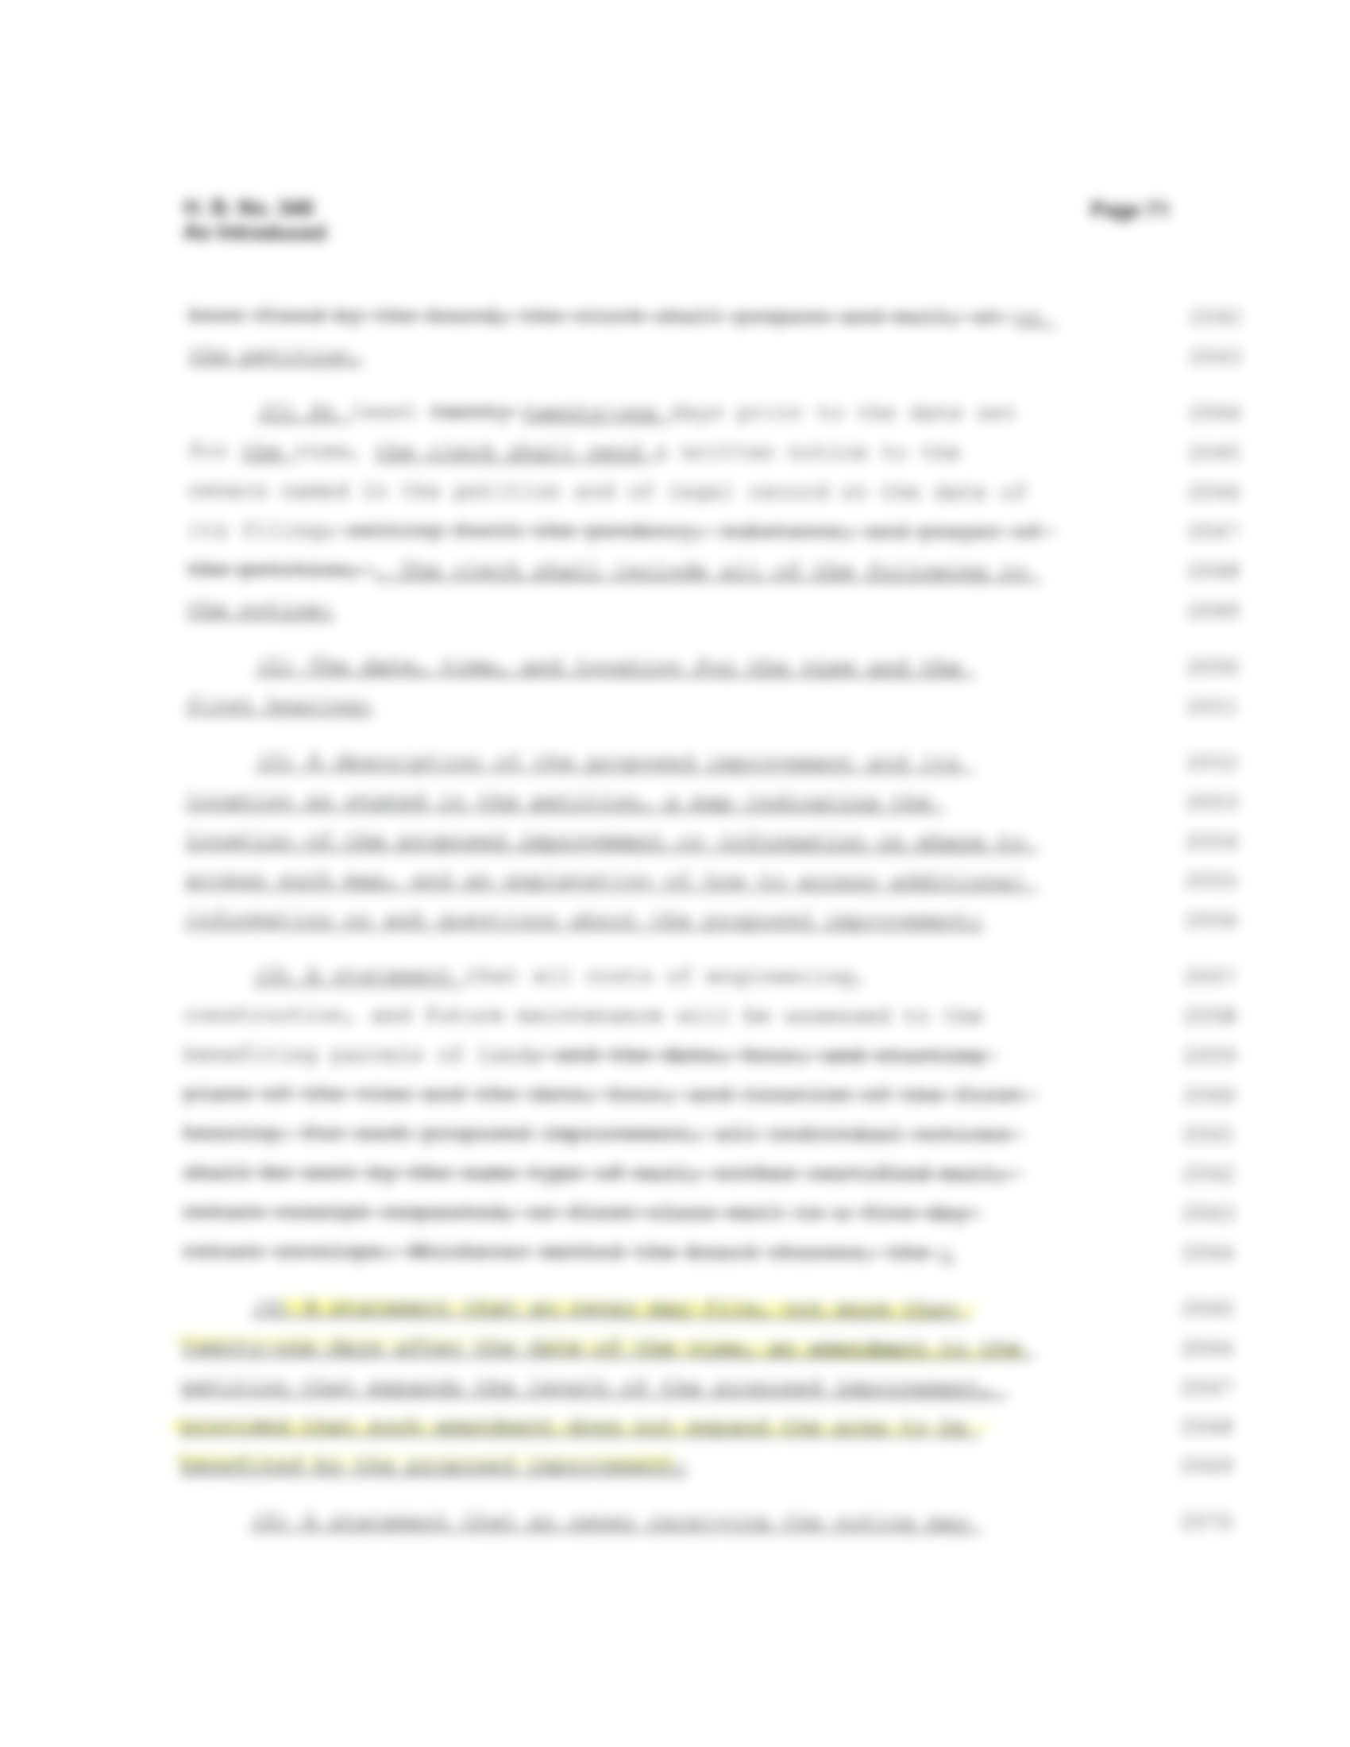


Slide 28




Slide 29




Slide 30




Slide 31



Slide 32




Slide 33



Slide 34




Slide 35




Slide 36




Slide 37
Questions??
Doug Reinhart, P.E., P.S.
Auglaize County Engineer
419-739-6520
dreinhart@auglaizecounty.org

